Slide 1

Swn
Small world networks

Slide 2
agenda
Introduction & surprise
What is SWN? – history through structure
Where SWN is in my life?
Visualizing results & conclusions
Testing the effects on community structuring
Final takeaways
Questions

Slide 3
Game time

Slide 4

Game time

Slide 5
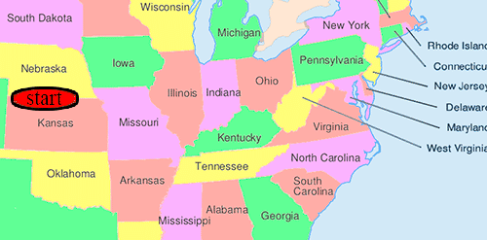
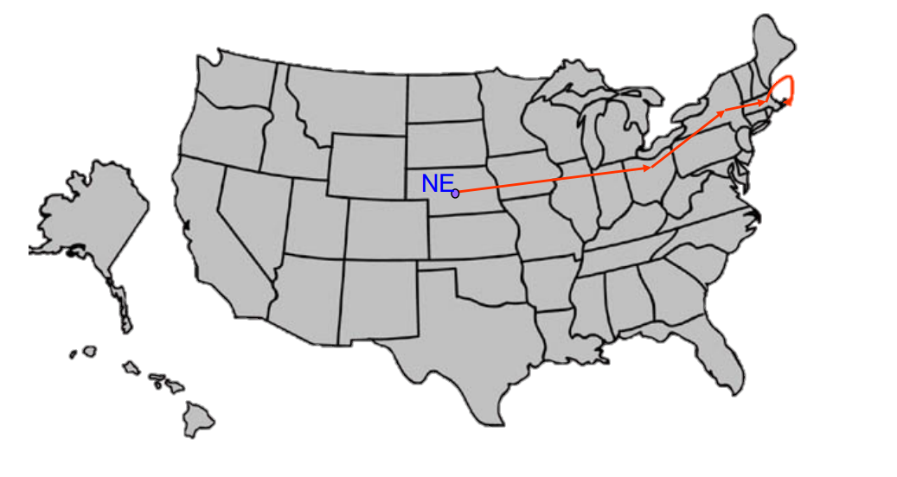
INTRODUCTION
Milgram’s experiment
20% of initiated chains reached target
Average chain length = 5.5~6

Slide 6

What is swn?
High Local Clustering
Short Global Distances
Notes:
Small world networks are connected graphs that exhibit two key characteristics: high local clustering and short global distances.
This means that nodes in the network are tightly connected to their immediate neighbors, but can also reach any other node in the network through a relatively small number of steps.

Slide 7

SWN are abundant in real life
Social Networks
Transportation networks
Biological Neural Networks
Electrical Power Grid
World Wide Web
Epidemic spread

Slide 8

Q1.
Why should there exist short chains of acquaintances linking together two arbitrary pairs of strangers?

Slide 9
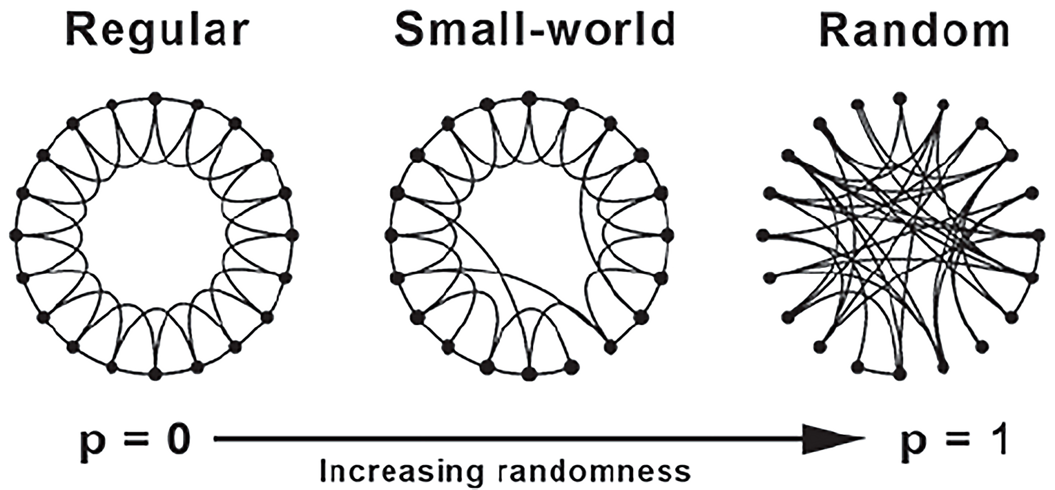
The watts-strogatz swn model

Slide 10
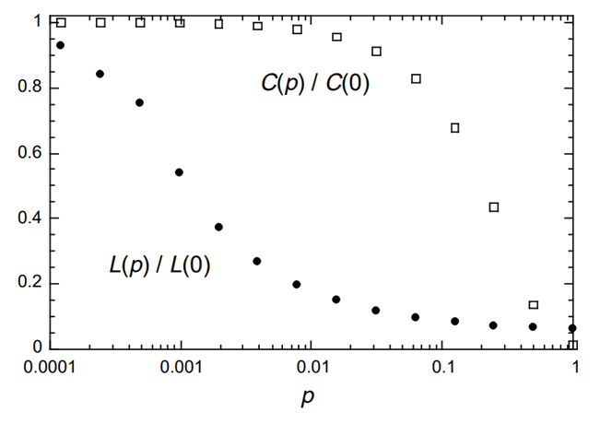
The watts-strogatz swn model
Notes:
Note that the p axis is in logarithmic scale
The underlying idea is the following:
For p ~ 0 there are no connections between distant nodes, so paths take a lot more, but the nodes are all clustered together.
As p grows, more connections between distant nodes occur acting as “shortcuts” so the distance drops exponentially.
As p grows further, it reaches a point where connections get replaced and neighbors start to become less clustered.

Slide 11
Q2.
Why should arbitrary pairs of strangers be able to find short chains of acquaintances that link them together?

Slide 12
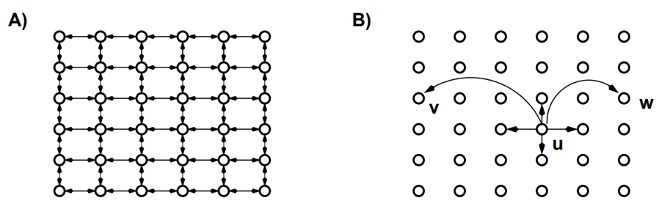
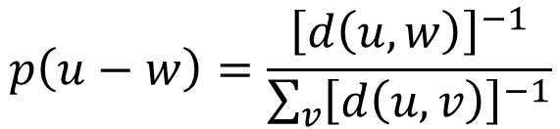
kLEINBERG’s model
The model
p = close neighbors’ distance
q = long range contacts
r = probability distribution factor
$$p\left(u−w\right)=\frac{{\left[d\left(u,w\right)\right]}^{−1}}{\sum_{v}{{\left[d\left(u,v\right)\right]}^{−1}}}$$
Notes:
the node u has a directed edge to every other node within lattice distance p — these are its local contacts
we also construct directed edges from u to q other nodes (the long-range contacts) using independent random trials; the i th directed edge from u has endpoint v with probability proportional to [d(u, v)]−r . (To obtain a probability distribution, we divide this quantity by the appropriate normalizing constant P v [d(u, v)]−r ; we will call this the inverse r th-power distribution.)

Slide 13
kLEINBERG’s model
kLEINBERG’s model
13
The Strategy
Decentralized Algorithms are mechanisms whereby the message is passed sequentially from a current message holder to one of its (local or long-range) contacts, using only local information. In particular, the message holder u in a given step has knowledge of:
the set of local contacts among all nodes (i.e. the underlying grid structure);
the location, on the lattice, of the target t; and
the locations and long-range contacts of all nodes that have come in contact with the message.

Slide 14
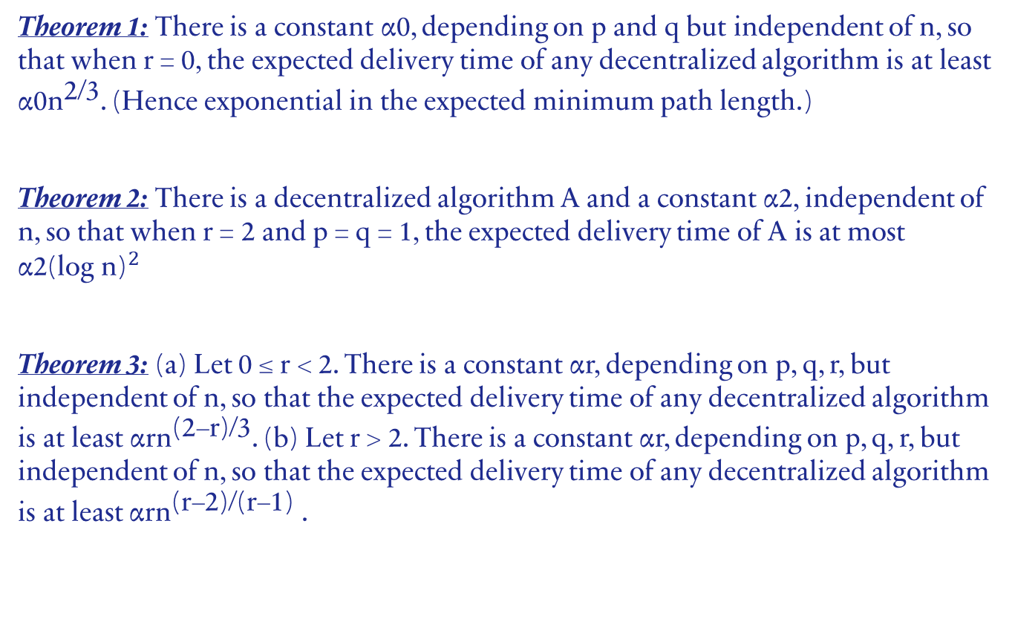
Jon Kleinberg’s theorems
Theorem 1: There is a constant α0, depending on p and q but independent of n, so that when r = 0, the expected delivery time of any decentralized algorithm is at least ${\text{α}\text{0}\text{n}}^{\text{2}\text{/}\text{3}}$. (Hence exponential in the expected minimum path length.)
Theorem 2: There is a decentralized algorithm A and a constant α2, independent of n, so that when r = 2 and p = q = 1, the expected delivery time of A is at most ${\text{α}\text{2}\text{(}\text{log} \text{n}\text{)}}^{2}$
Theorem 3: (a) Let 0 ≤ r < 2. There is a constant αr, depending on p, q, r, but independent of n, so that the expected delivery time of any decentralized algorithm is at least ${\text{α}\text{rn}}^{\text{(}\text{2}\text{−}\text{r}\text{)/}\text{3}}$. (b) Let r > 2. There is a constant αr, depending on p, q, r, but independent of n, so that the expected delivery time of any decentralized algorithm is at least${\text{α}\text{rn}}^{\text{(}\text{r}\text{−}\text{2}\text{)/(}\text{r}\text{−}\text{1}\text{)}}$ .

Slide 15
kLEINBERG’s model
kLEINBERG’s model
15
Results
When r=0 (uniform distribution), there exist short chains, however there is no way for a decentralized algorithm to find these chains.
When long-range contacts are formed by a process that is related to the geometry of the grid, the short chains will still form and nodes operating with local knowledge only, will be able to construct them.
r=2 is the only value for which there is a decentralized algorithm capable of producing chains whose length is a polynomial in log(n)

Slide 16
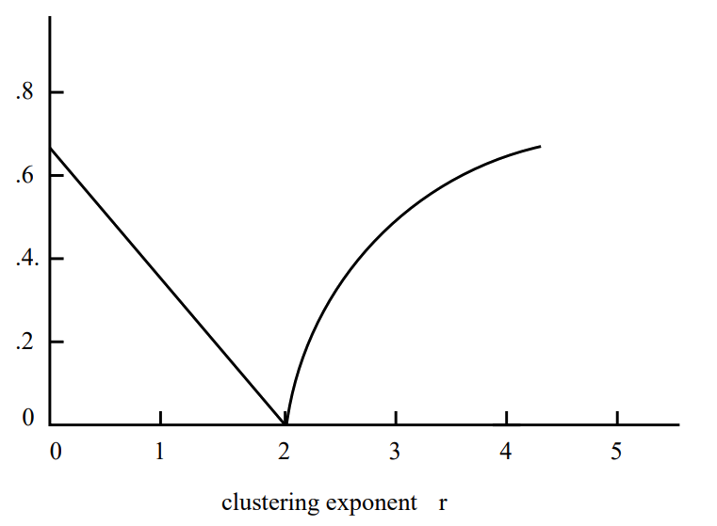
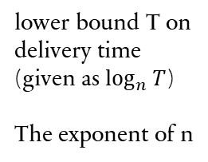
kLEINBERG’s model
kLEINBERG’s model
16
Bottom line
The correlation between local structure and long-range connections provides fundamental cues for finding paths through the network
When this correlation is near a critical threshold, (r=2) the structure of the long-range connections allows individuals to guide a message efficiently toward a target
lower bound T on delivery time (given as $\log_{n}{T}$)
The exponent of n

Slide 17
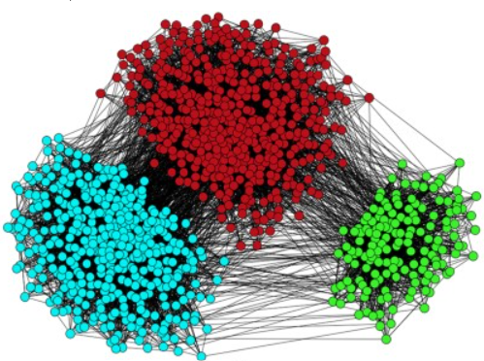
communities
In social networks and other real-world networks, people or nodes naturally tend to form groups or communities based on shared interests, activities, or connections. This clustering phenomenon is essential because it reflects the underlying structure and dynamics of the network, revealing how information, influence, and relationships propagate within and across these groups.

Slide 18
Community detection
Louvain Algorithm
Community detection algorithms identify and analyze clusters within networks, revealing underlying structures and dynamics. The Louvain method is a popular algorithm for this purpose, known for its efficiency and ability to uncover hierarchical community structures. It works by iteratively optimizing modularity, a measure of the density of links within communities compared to between them.

Slide 19
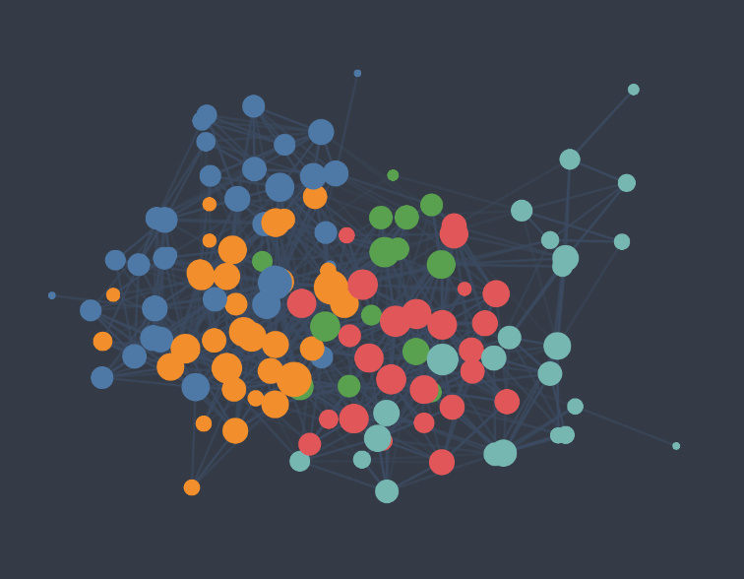
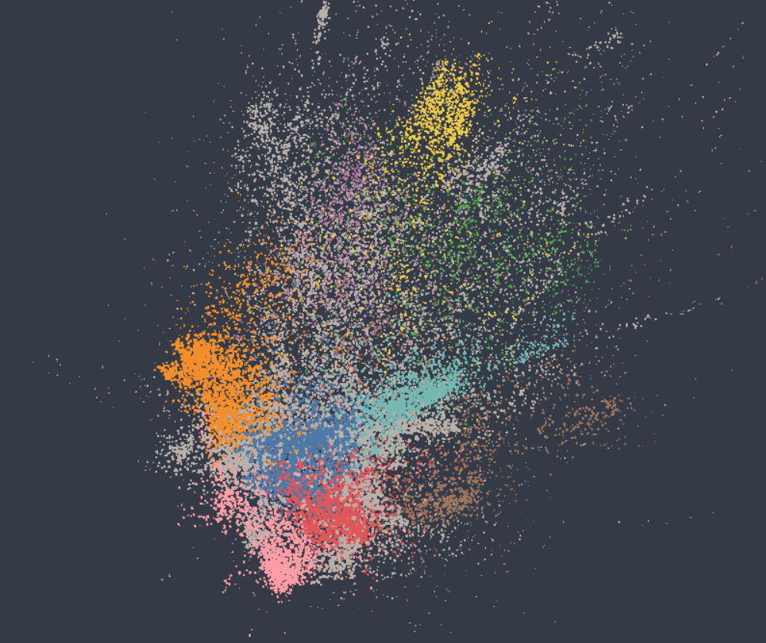
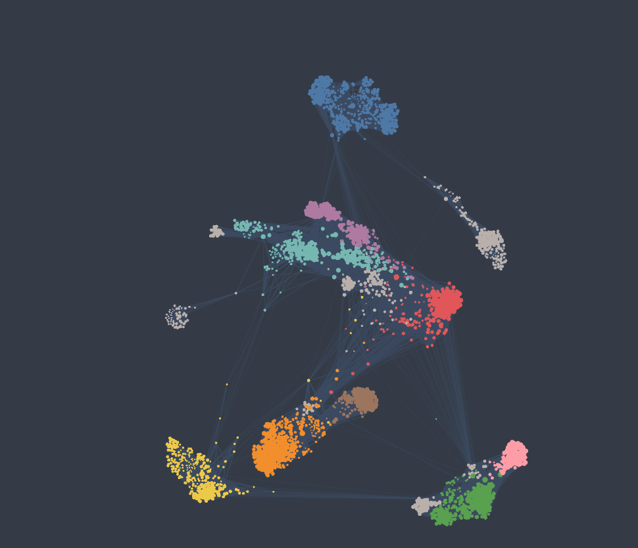
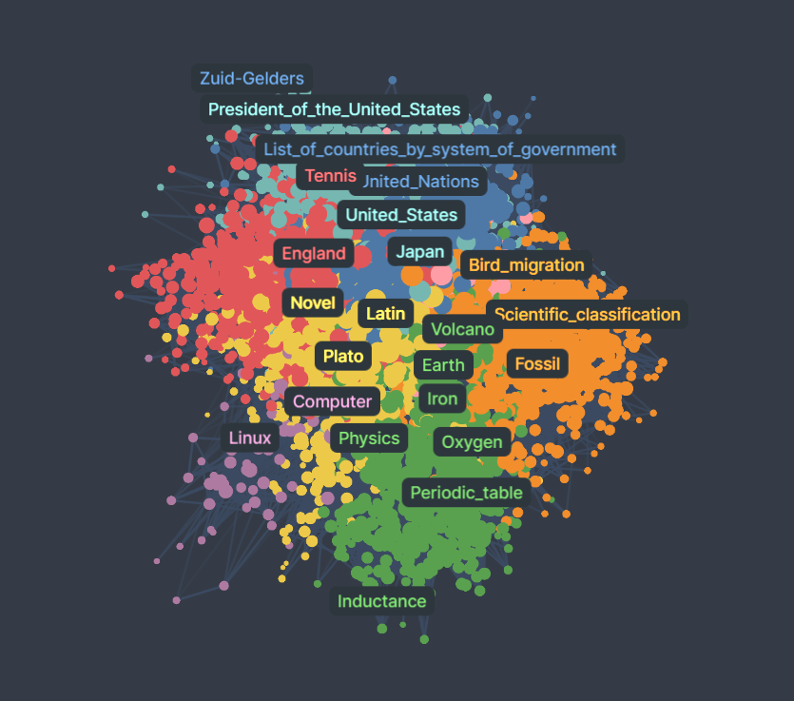
Neural Network of C. Elegans
Articles citations
Wikipedia hyperlinks
Facebook group

Slide 20
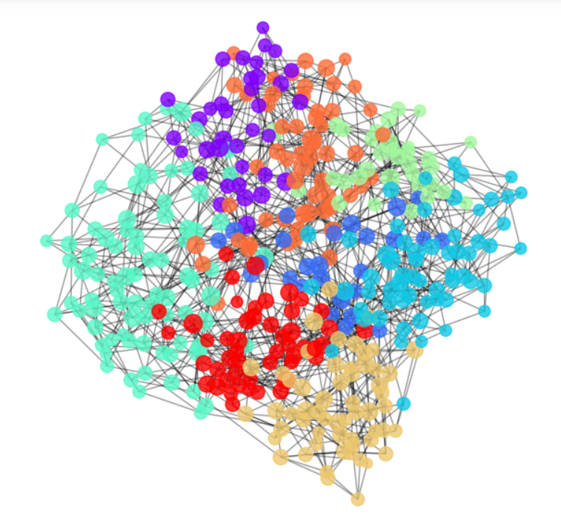
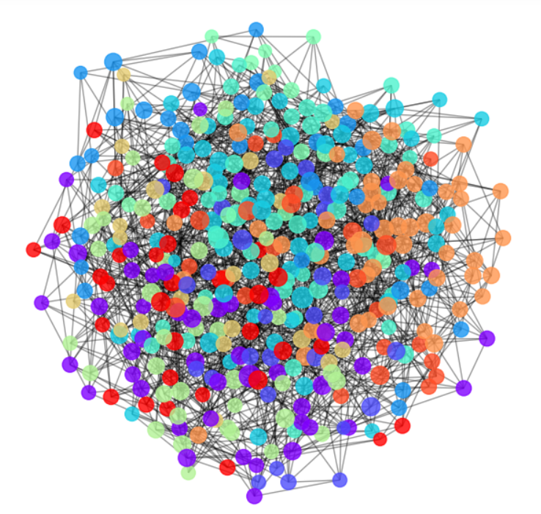
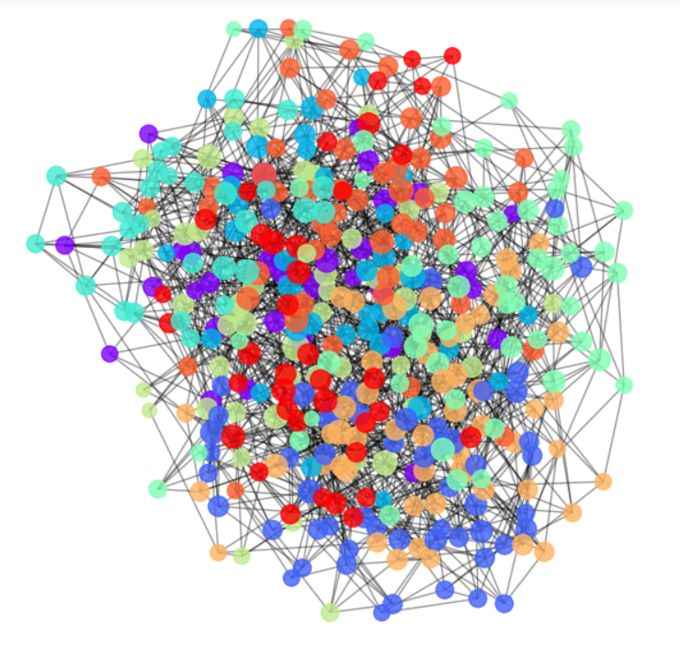
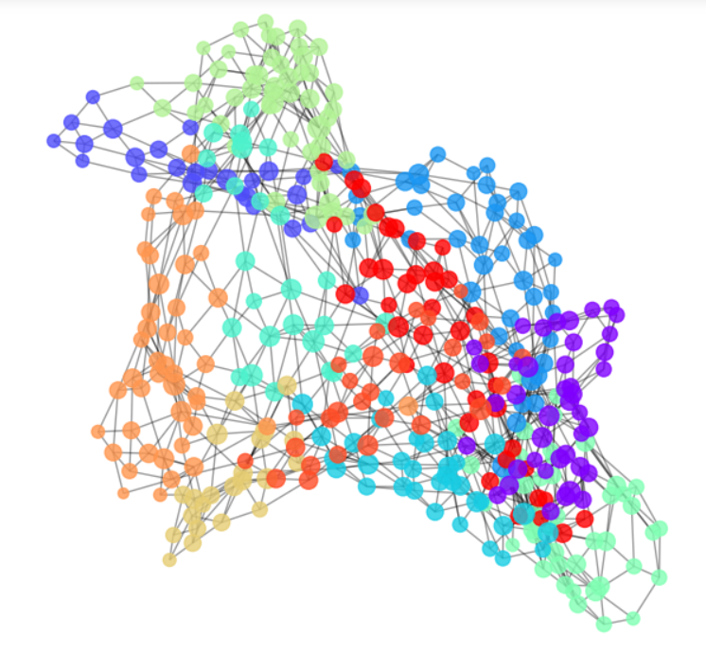
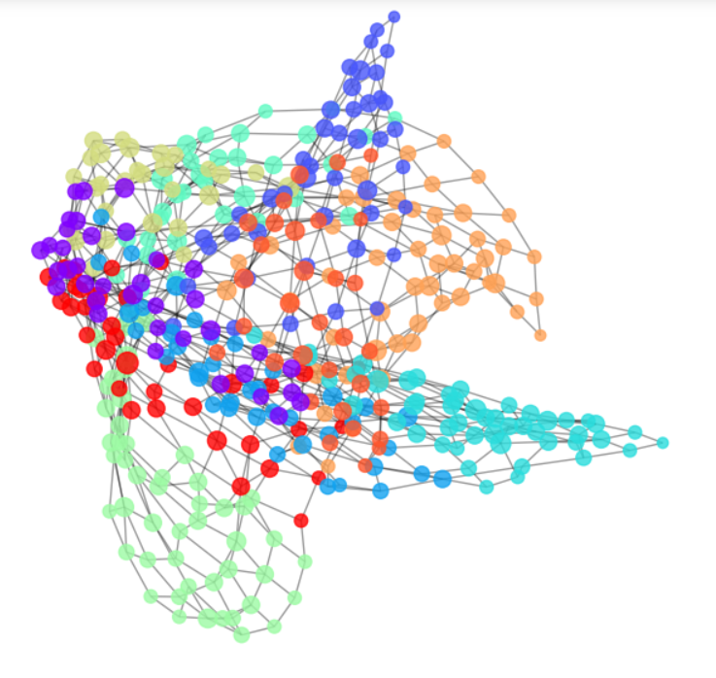
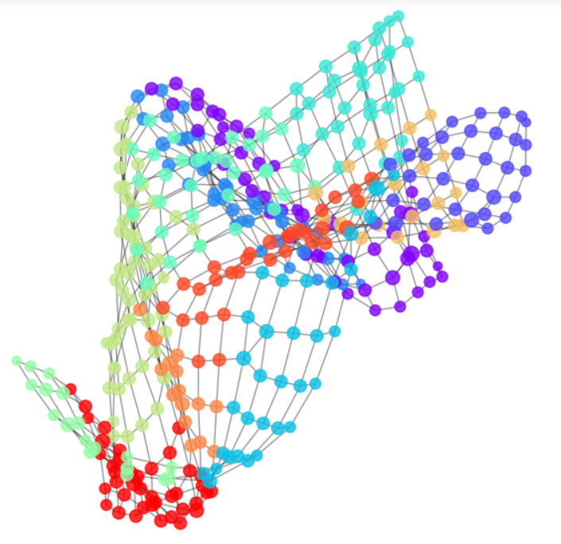
p = ? , q = ?
r=1
r=2
r=0
r=3
r=4
r=5

Slide 21
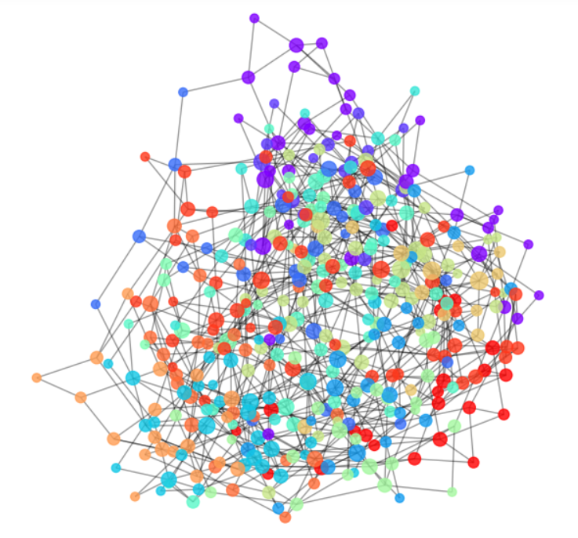
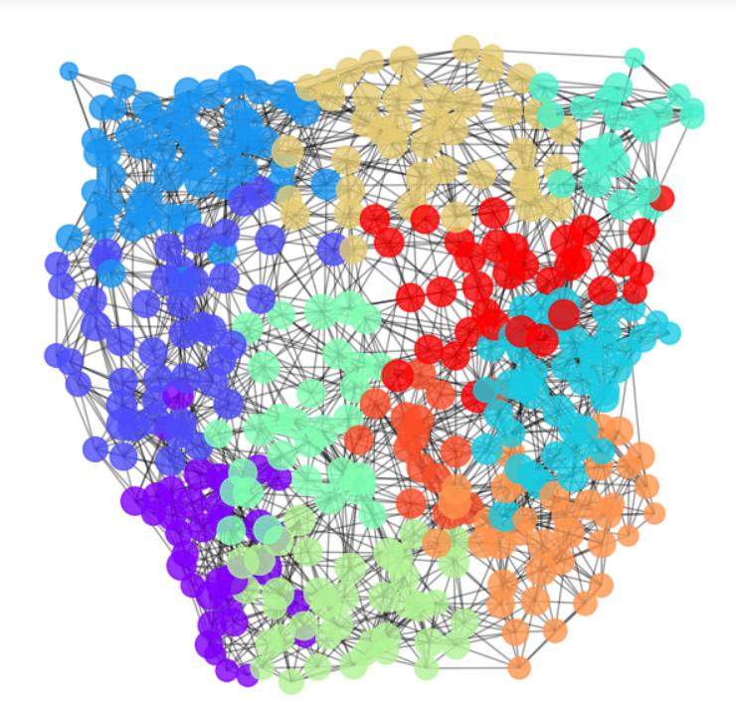
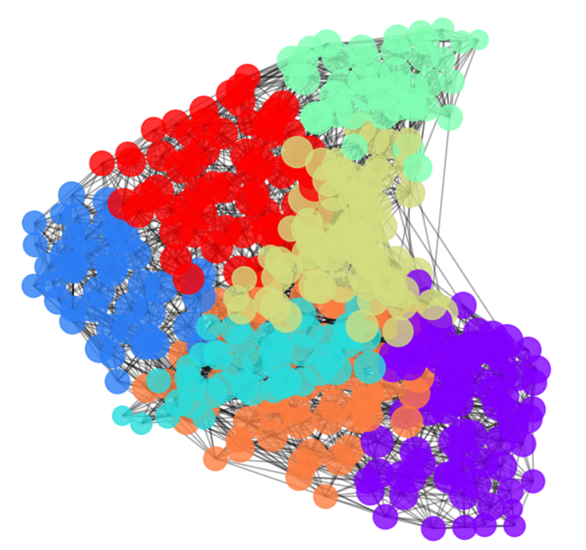
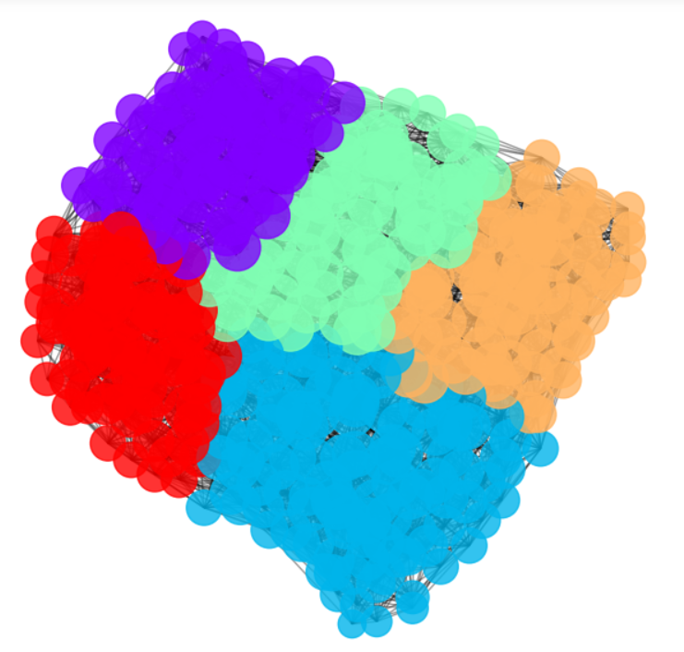
r = ? , q = ?
p=0
p=1
p=2
p=3
p=4

Slide 22
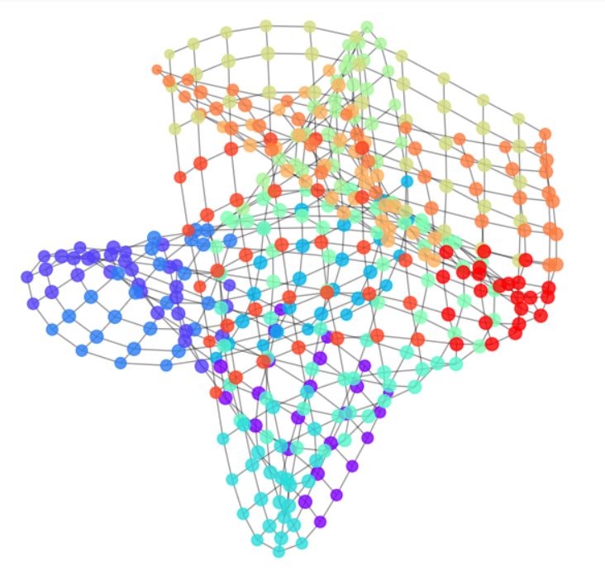
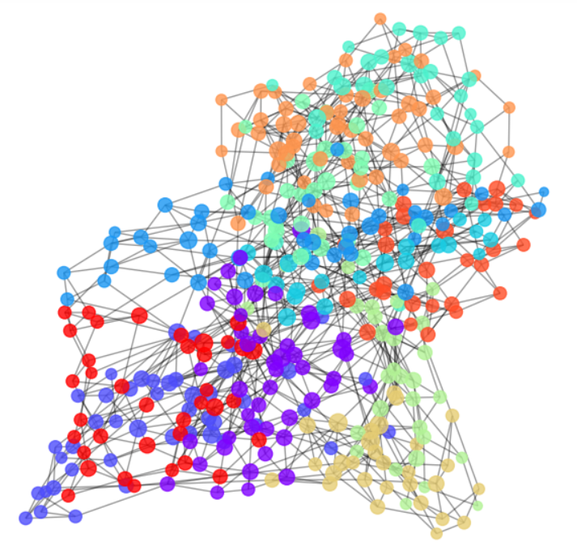
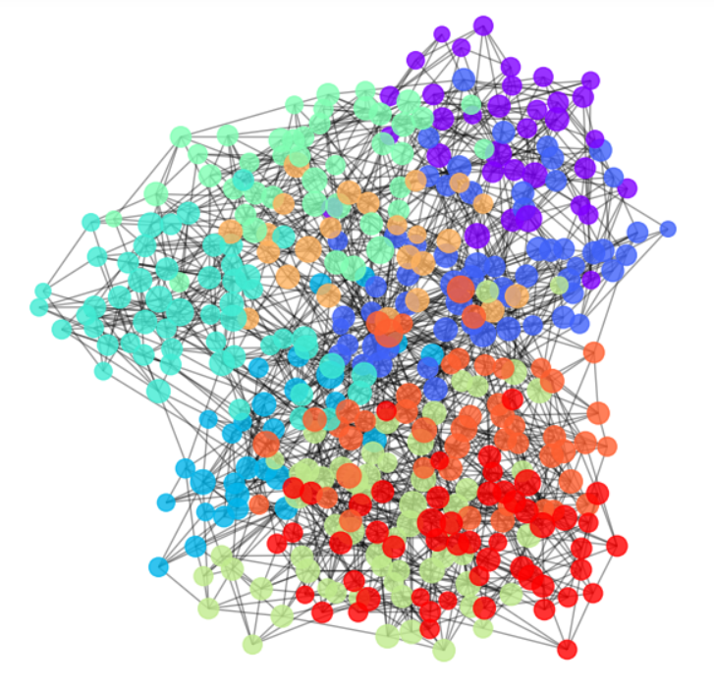
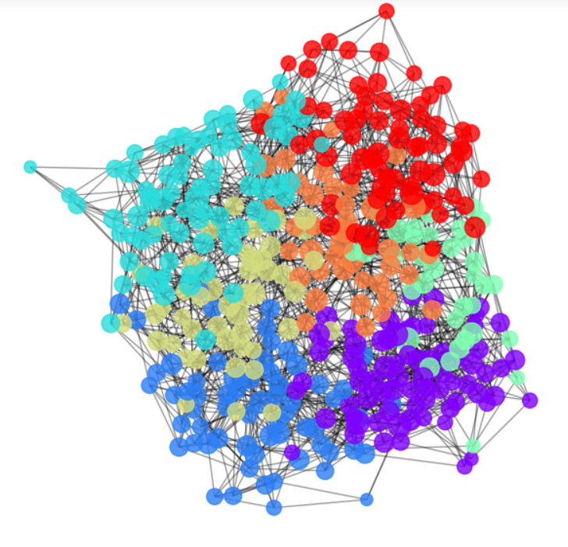
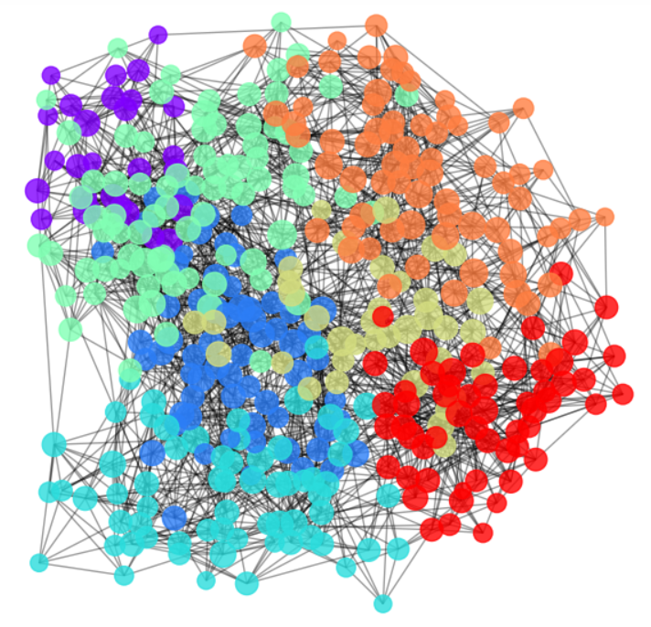
p = ? , r = ?
q=0
q=1
q=2
q=3
q=4
q=5

Slide 23
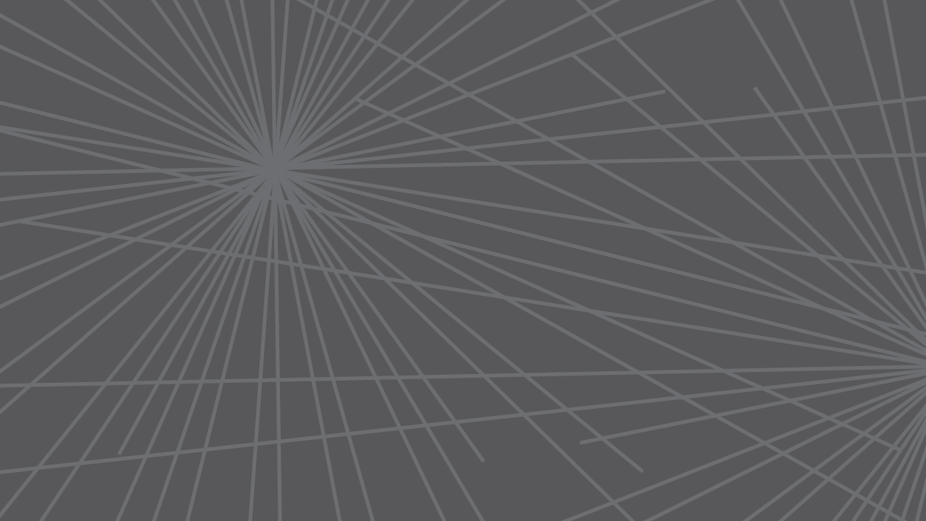
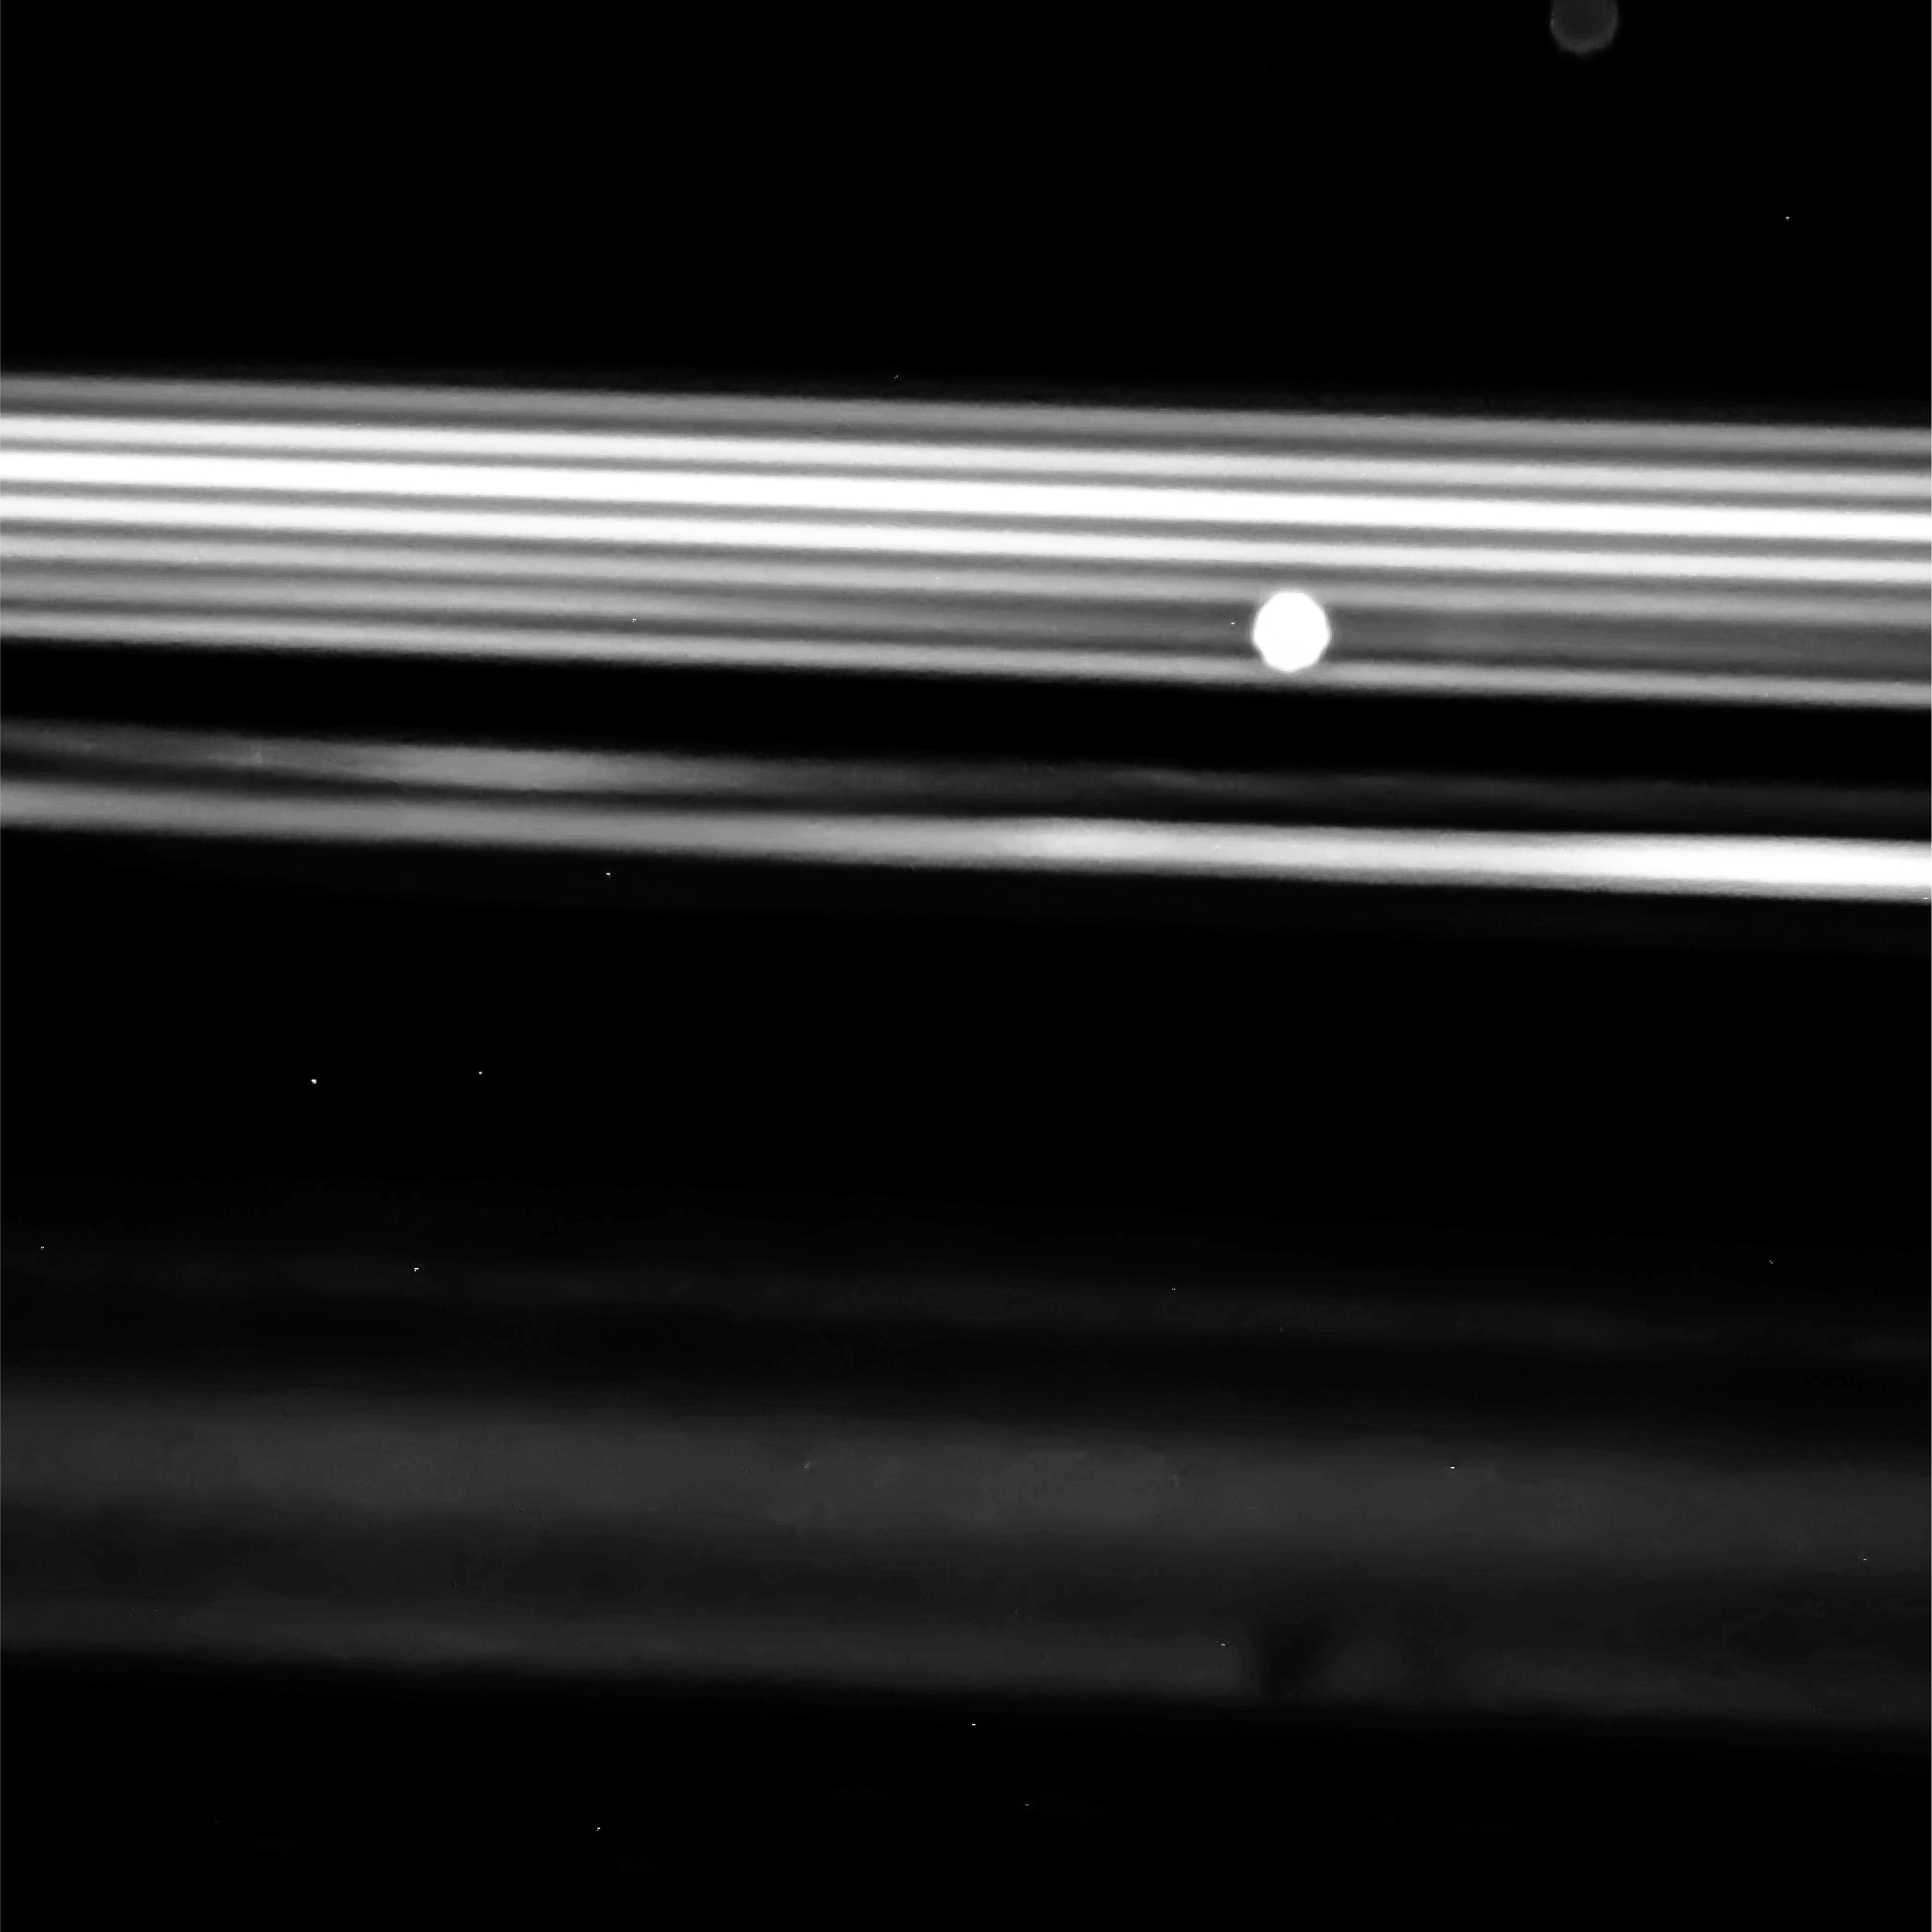


Visualizing results & conclusions

Slide 24
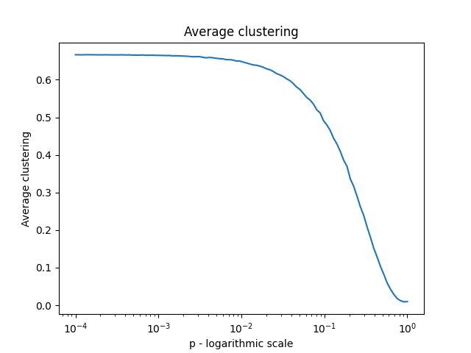
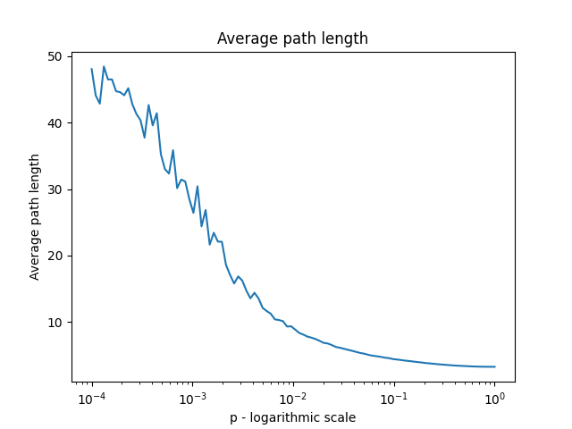
Replicating tests
Notes:
Parameters used are identical to original article i.e. n=1000 k=10

Slide 25
Replicating tests
Notes:
Parameters used are identical to original article i.e. n=1000 k=10

Slide 26
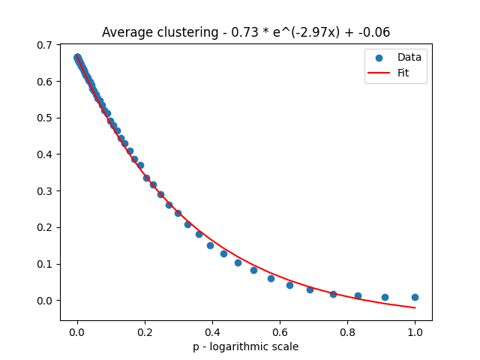
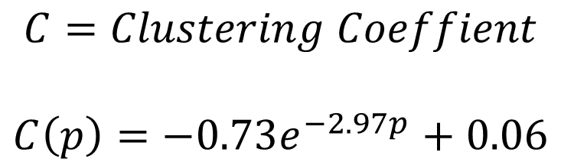
P-C relation
$$C=Clustering Coeffient$$
$$C\left(p\right)=−0.73e^{−2.97p}+0.06$$
Notes:
Using curve fitting for exponent

Slide 27
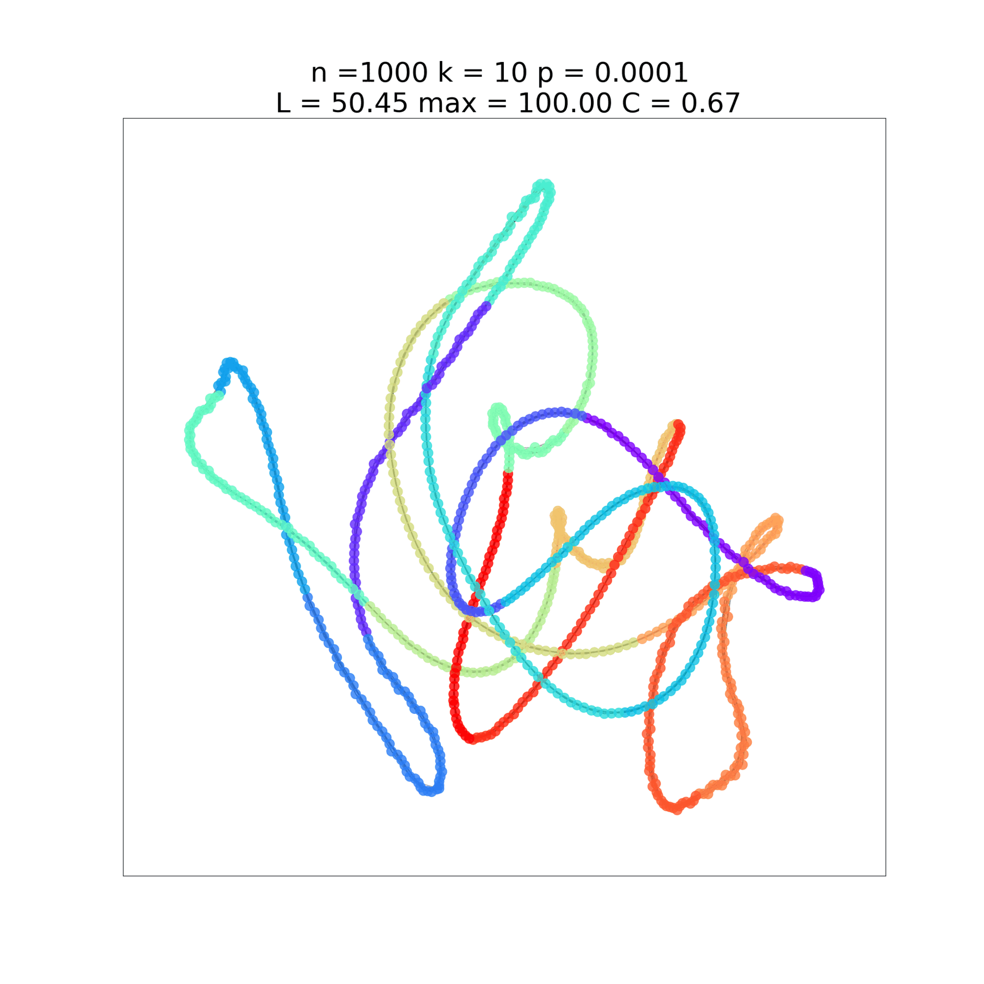
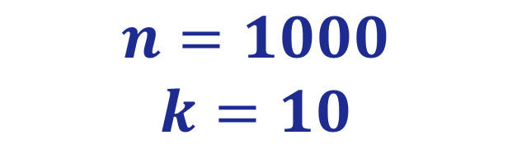
Visualizing results
$$n=1000$$
$$k=10$$

Slide 28
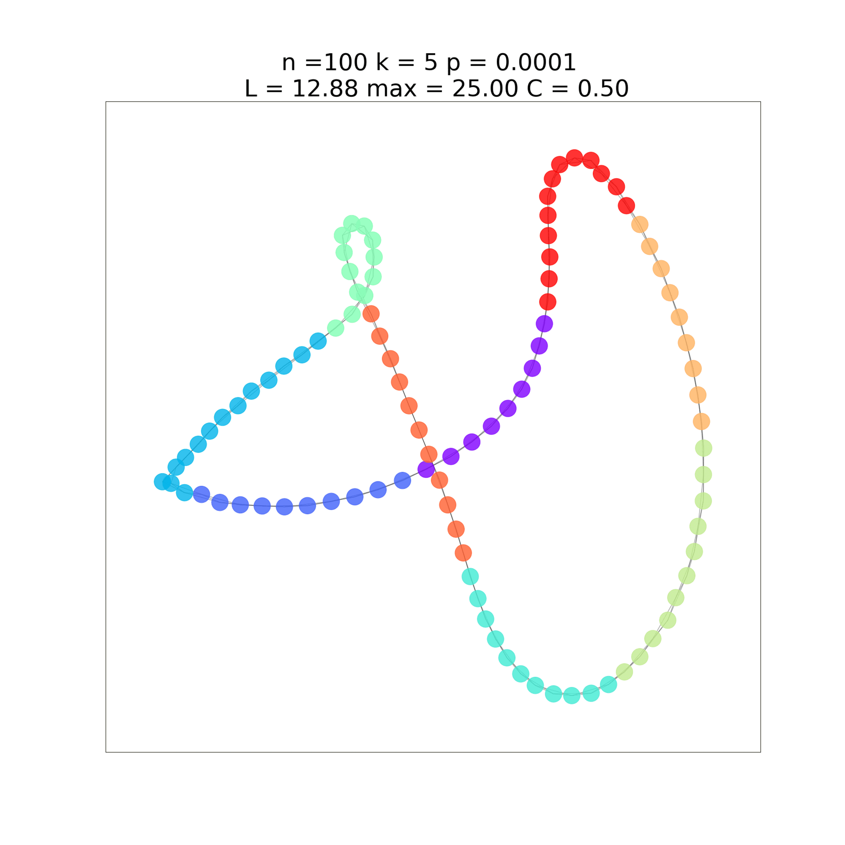

Visualizing results
$$n=100$$
$$k=5$$

Slide 29
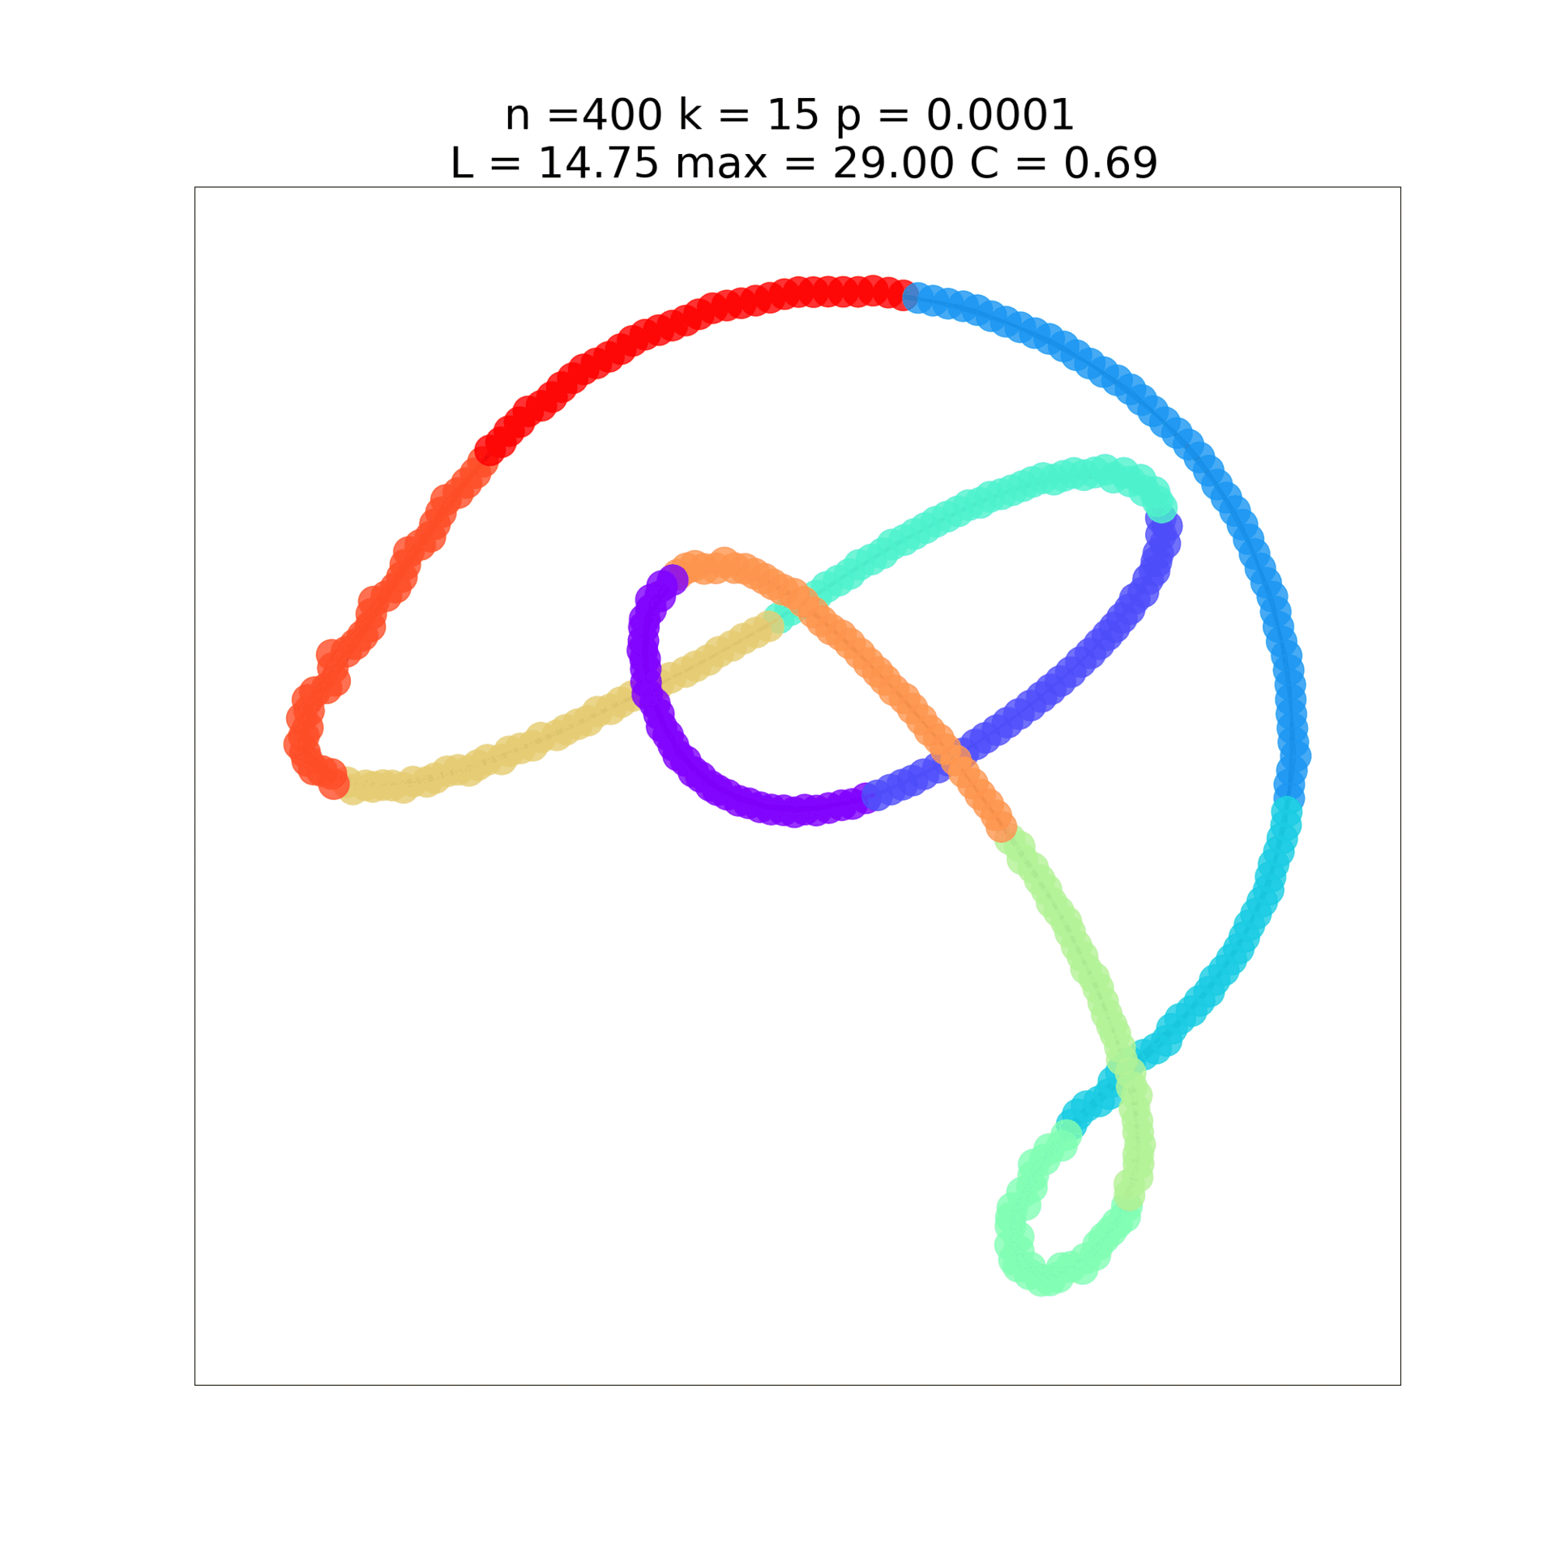
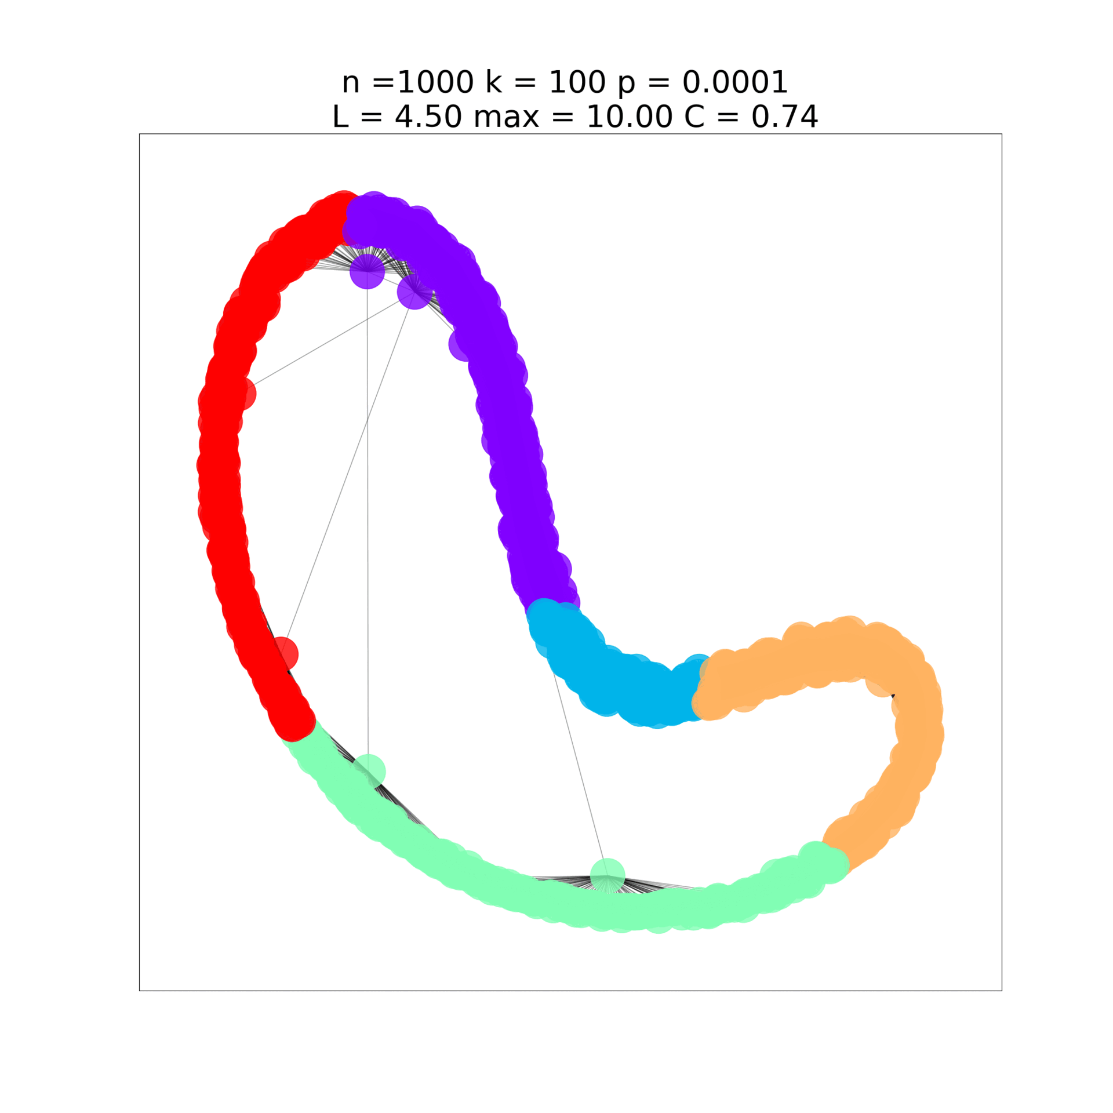

Slide 30
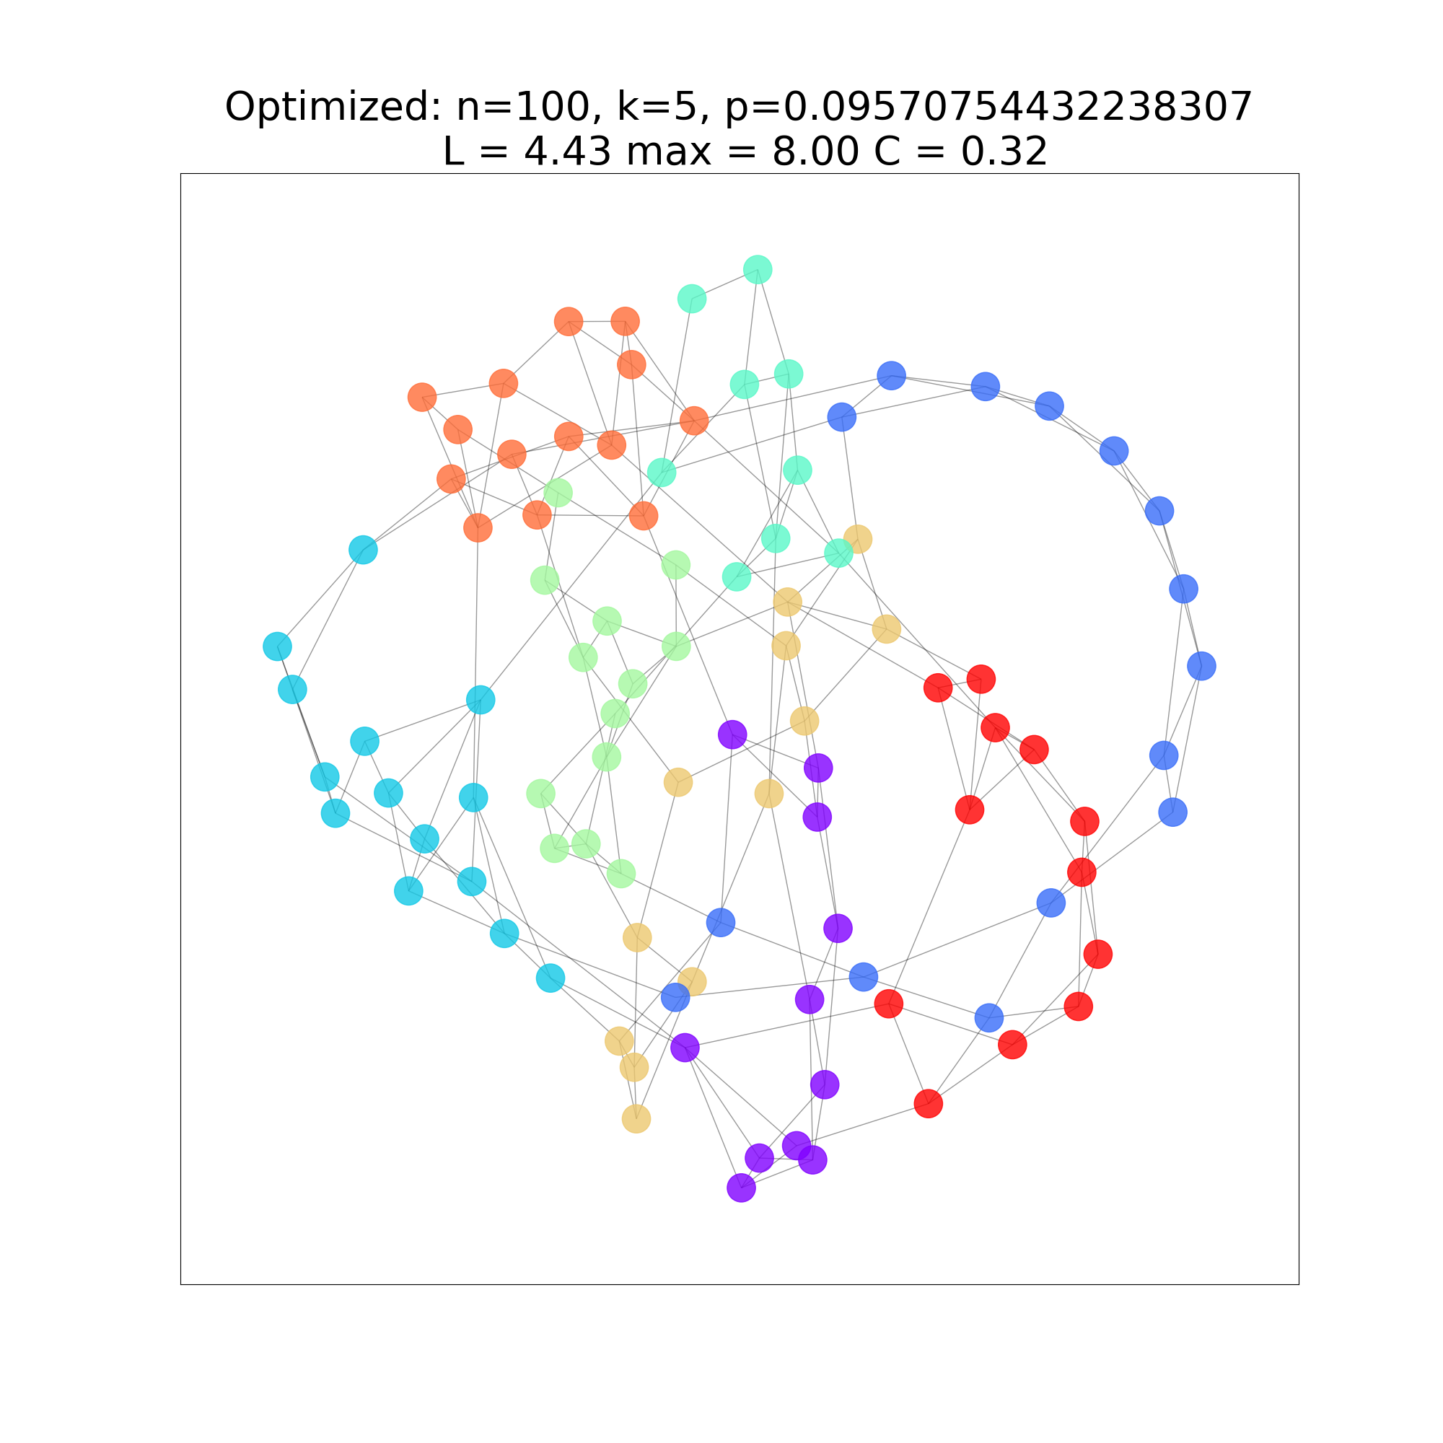
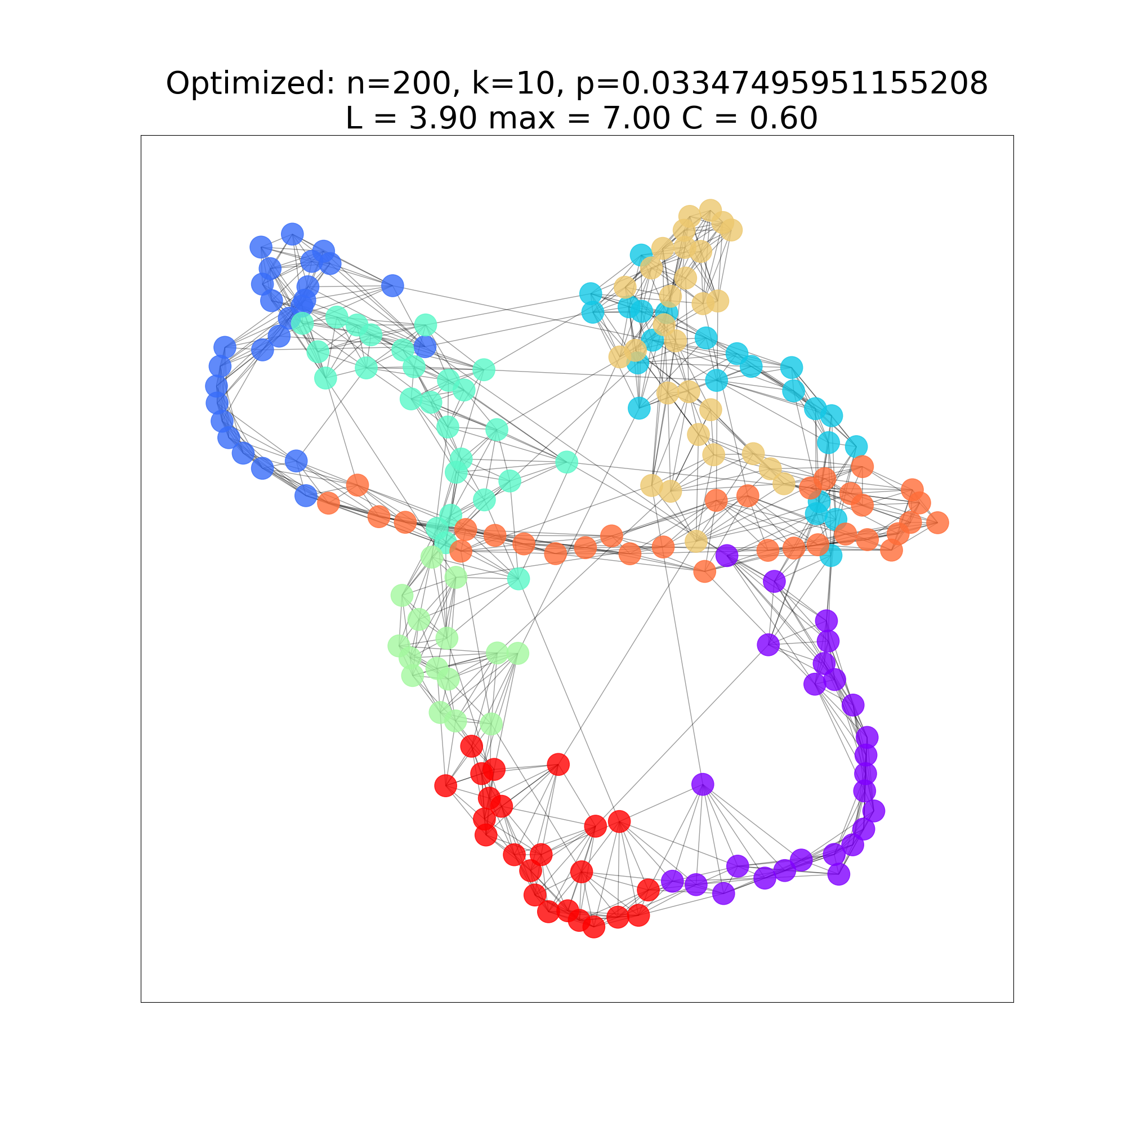
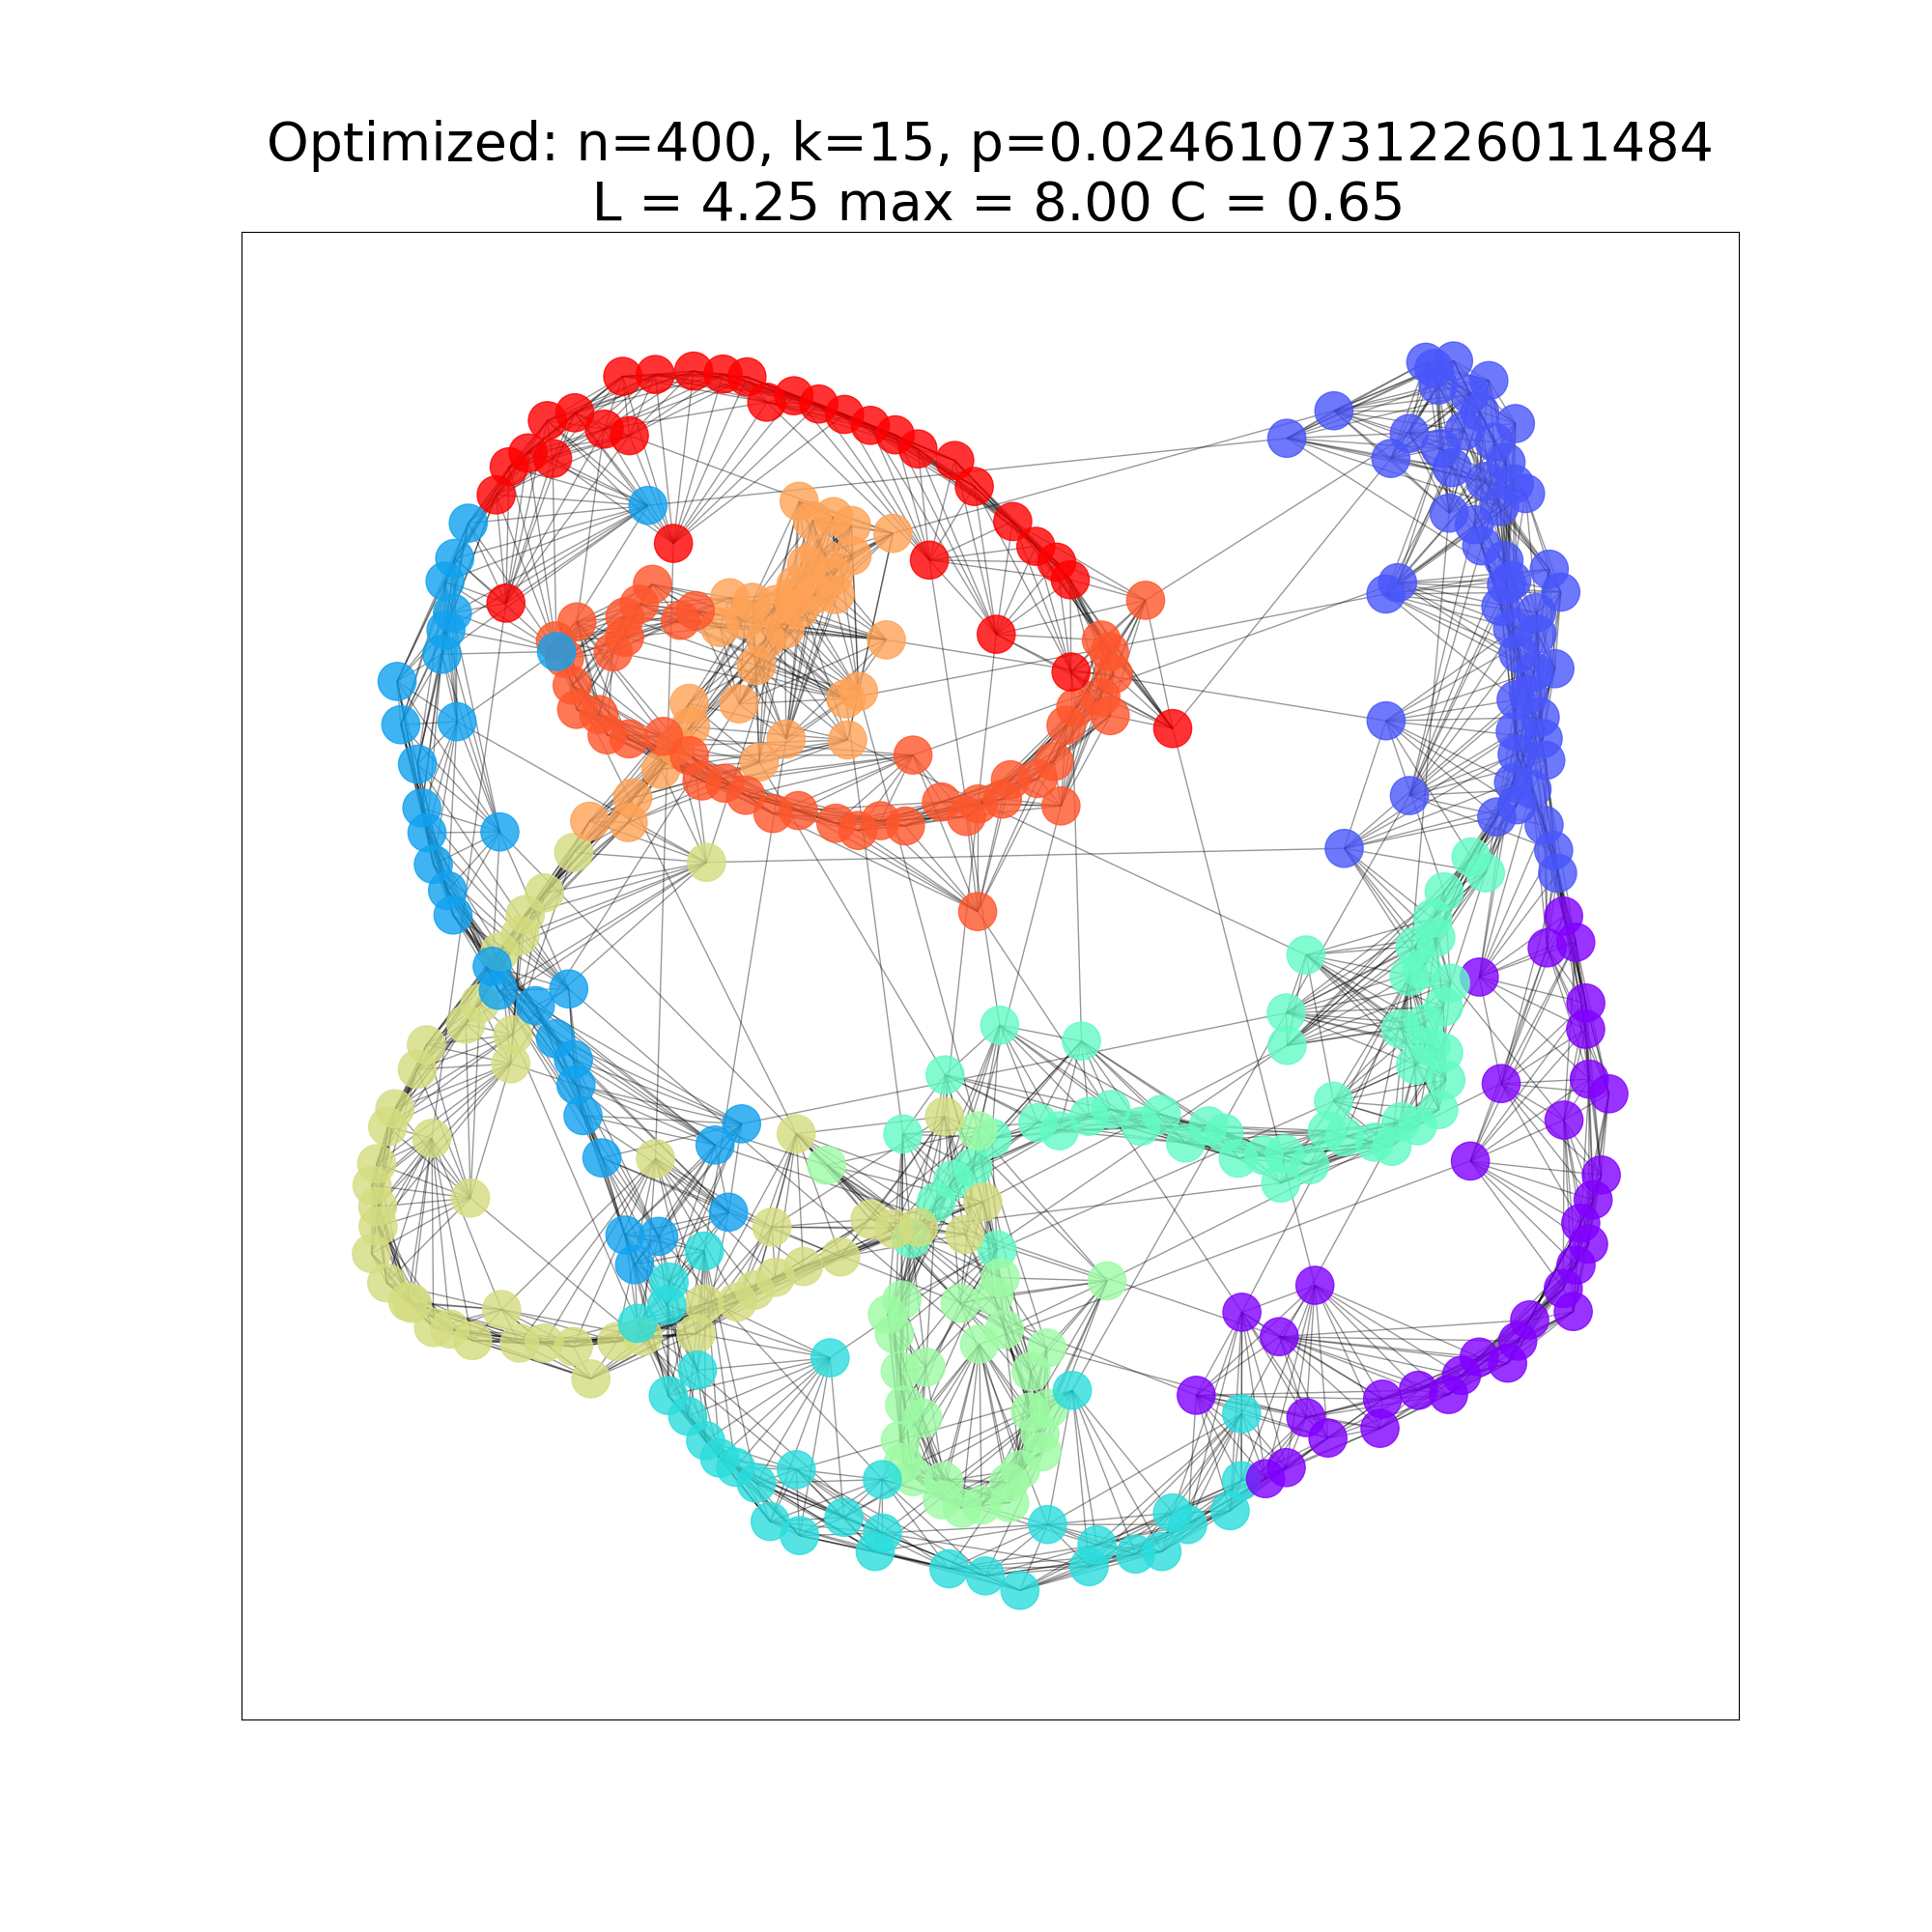
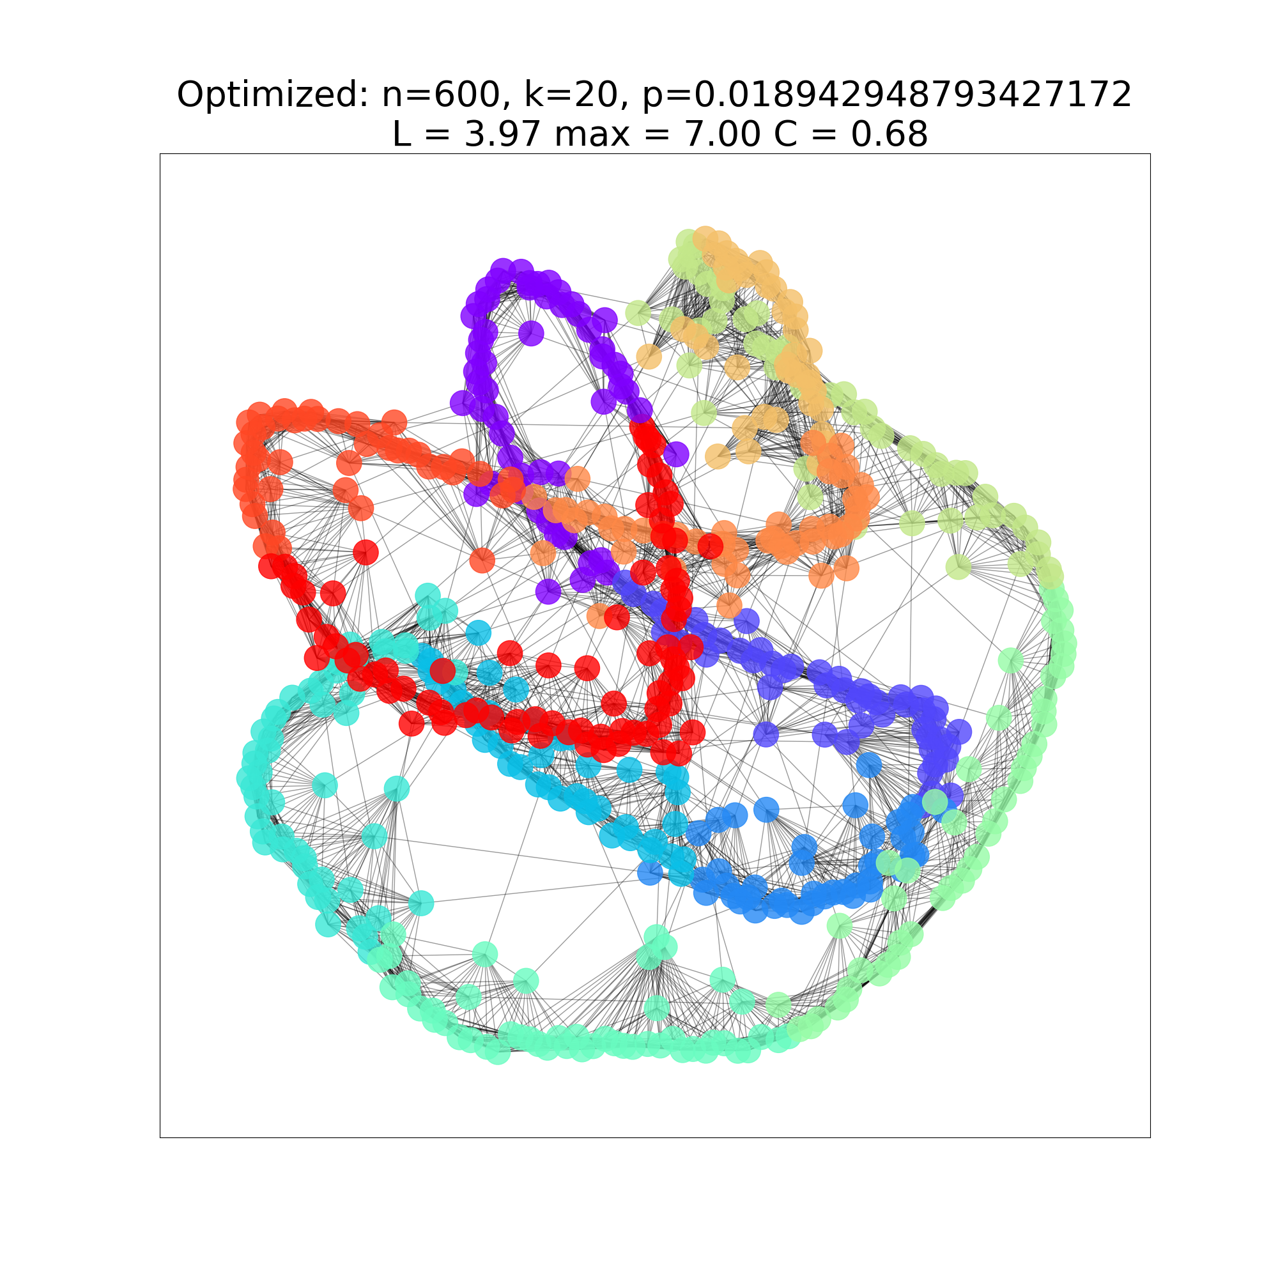
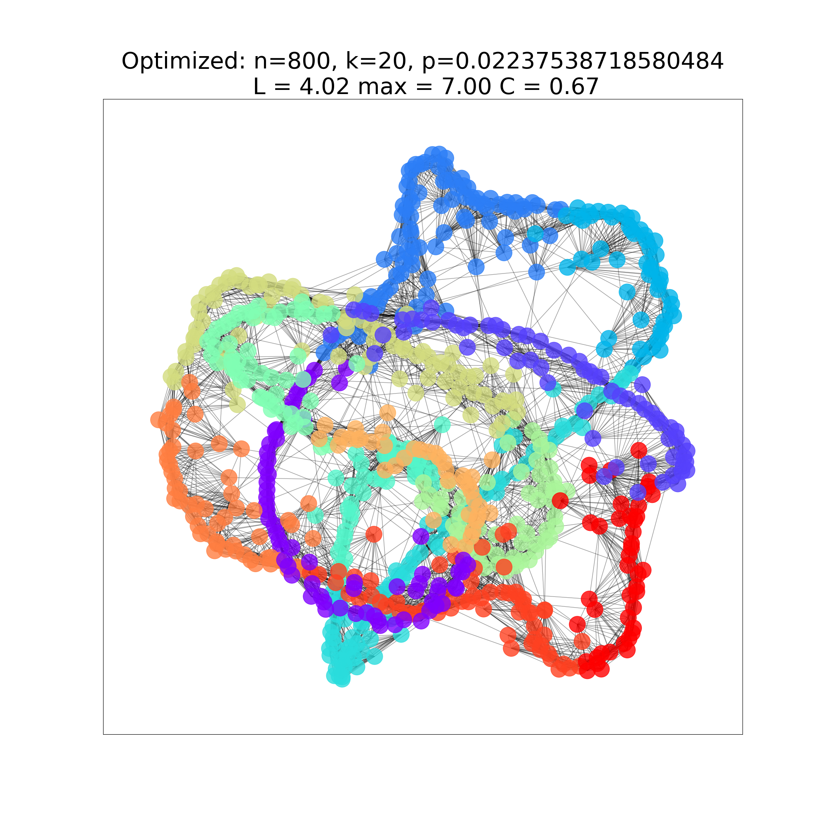
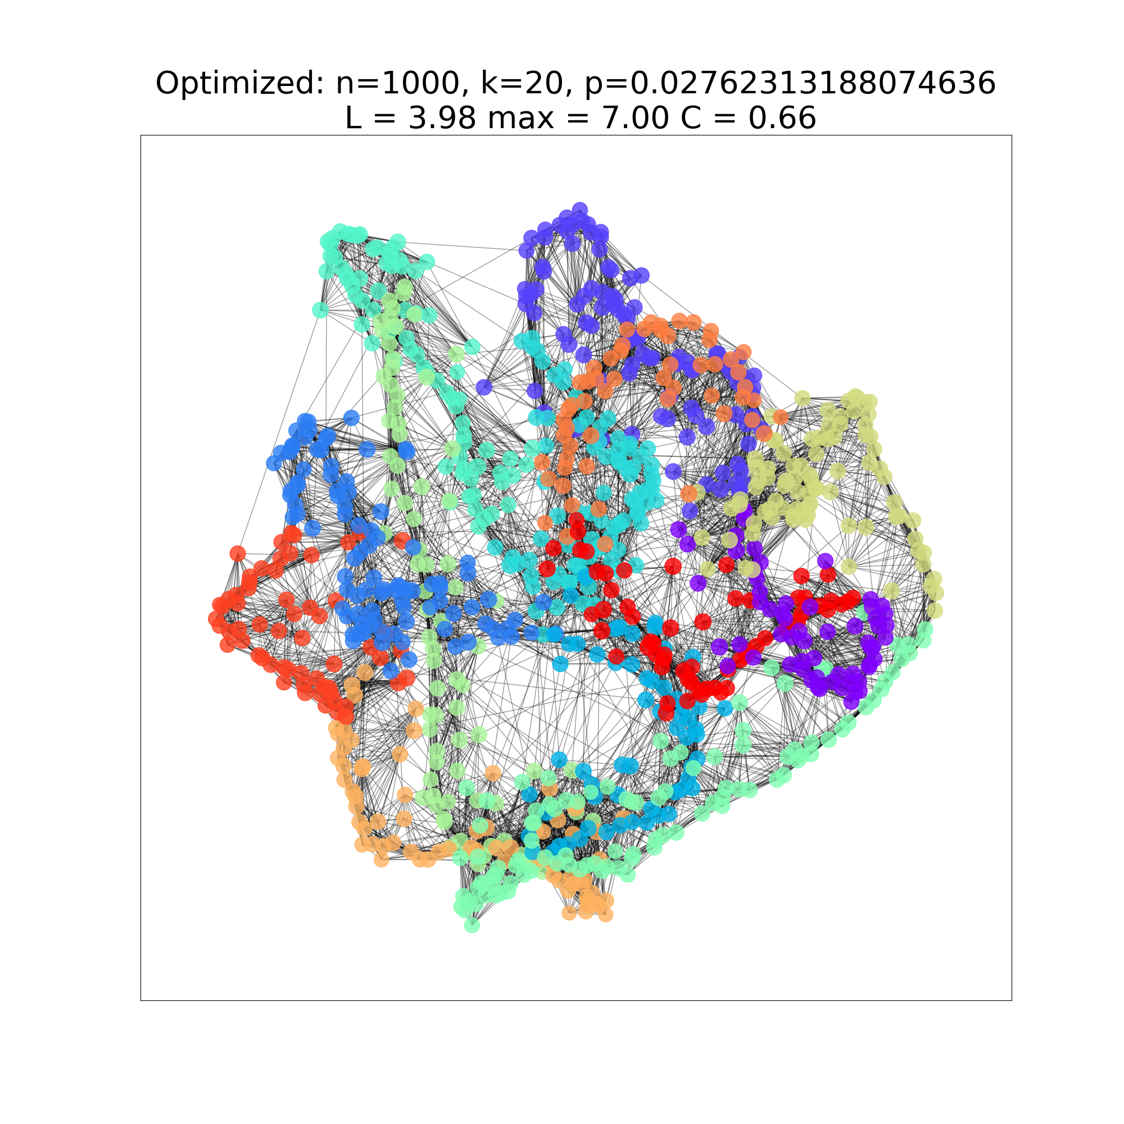
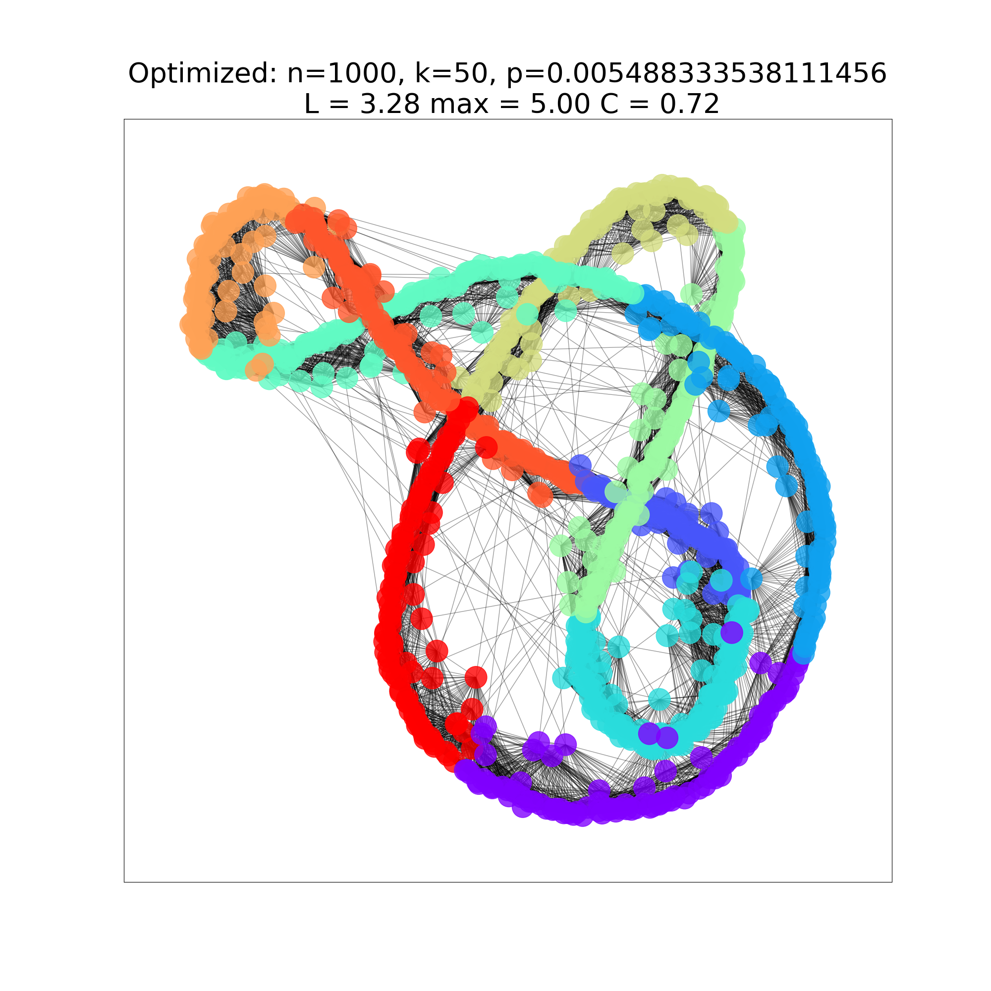
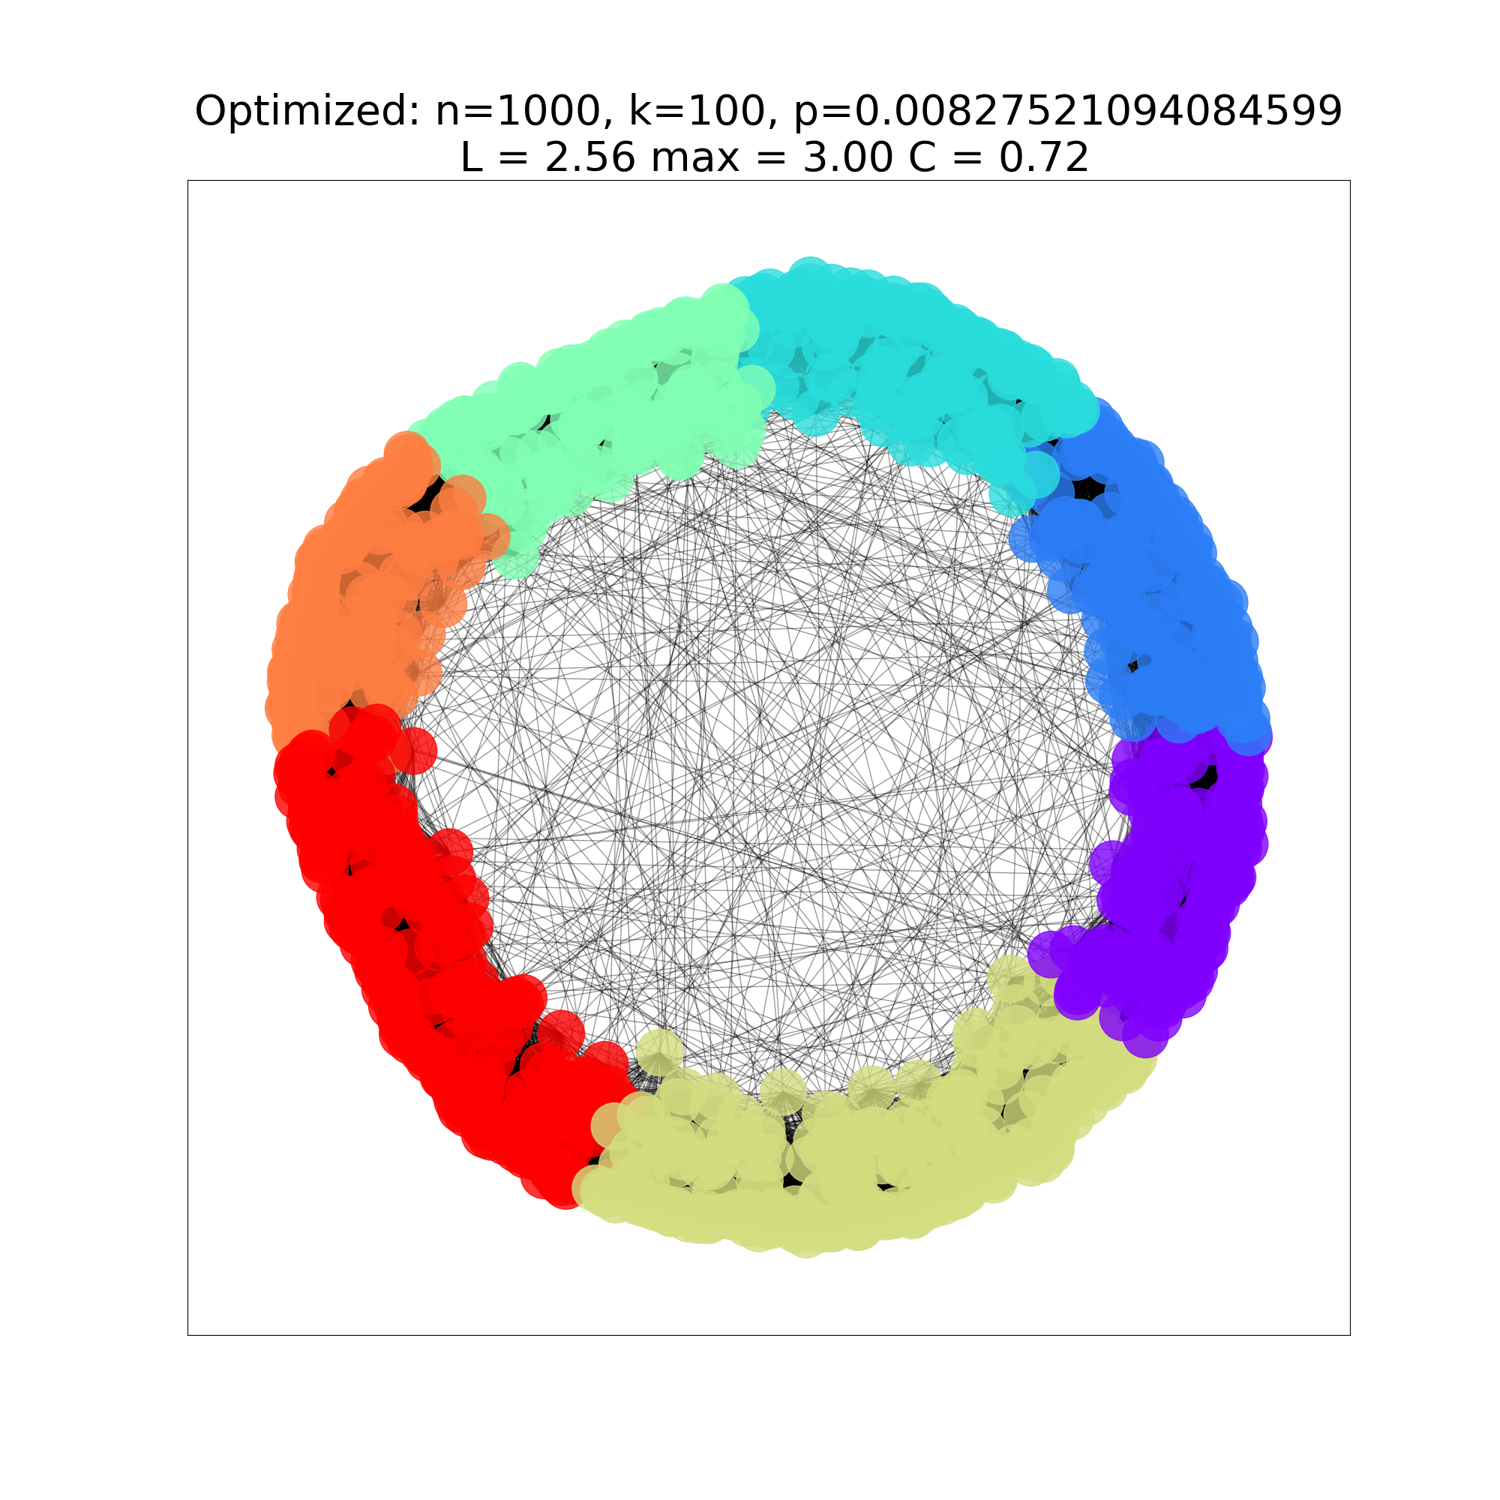
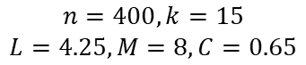
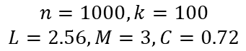














Finding the sweet Spot
$$n=100, k=5$$
$$L=4.43, M=8, C=0.32$$
$$n=200, k=10$$
$$L=3.90, M=7, C=0.60$$
$$n=400, k=15$$
$$L=4.25, M=8, C=0.65$$
$$n=600, k=20$$
$$L=3.97, M=7, C=0.68$$
$$p=0.095707$$
$$p=0.033474$$
$$p=0.024610$$
$$p=0.018942$$
$$n=800, k=20$$
$$L=4.02, M=7, C=0.67$$
$$n=1000, k=20$$
$$L=3.98, M=7, C=0.66$$
$$n=1000, k=50$$
$$L=3.28, M=5, C=0.72$$
$$n=1000, k=100$$
$$L=2.56, M=3, C=0.72$$
$$p=0.022375$$
$$p=0.027623$$
$$p=0.005488$$
$$p=0.008275$$
Notes:
Using optimizing techniques - differential_evolution
To iterate on fixed n and k to find for which p the sum of the average path length, maximum path length minus the clustering coeffiecnt (scaled) takes a minimum

Slide 31
Final takeaways
SNW is everywhere
The power of models
The Future

Slide 32
Thank you!
Questions?

Slide 33
What is SNW?
A classic module build
In particular, the message holder u’, in a given step, has knowledge of:
the set of local contacts among all nodes (i.e. the underlying grid structure);
the location, on the lattice, of the target t; and
the locations and long-range contacts of all nodes that have come in contact with the message.
Crucially, u does not have knowledge of the long-range contacts of nodes that have not touched the message.

Slide 34
What is SNW?
Results of Jon Kleinberg’s study
Their results explore the way in which the structure of the network affects the ability of a decentralized algorithm to construct a short path.
R – the ______________________
When r = 0 — the uniform distribution over long-range contacts —
(standard results from random graph theory can be used to show that with high probability there exist paths between every pair of nodes whose lengths are bounded by a polynomial in log n, exponentially smaller than the total number of nodes. However, there is no way for a decentralized algorithm to find these chains)
As the parameter r increases, a decentralized algorithm can take more advantage of the “geographic structure” implicit in the long-range contacts;
at the same time, long-range contacts become less useful in moving the message a large distance.
There is a value of r where this trade-off can be best exploited algorithmically; this is r = 2, the inverse-square distribution.

Slide 35
Module enhancements
K - dimensions
Community nodes
“Between” nodes
Changing the knowledge available to the algorithm

Slide 36
Where SNW is in my life?
Corona virus
Airplane
AI

Slide 37
Our attempt at optimizing a SNW

Slide 38
& Testing the effect of community nodes

Slide 39
Effective delivery techniques
This is a powerful tool in public speaking. It involves varying pitch, tone, and volume to convey emotion, emphasize points, and maintain interest.
Pitch variation
Tone inflection
Volume control
Effective body language enhances your message, making it more impactful and memorable.
Meaningful eye contact
Purposeful gestures
Maintain good posture
Control your expressions

Slide 40
Dynamic delivery
Learn to infuse energy into your delivery to leave a lasting impression
One of the goals of effective communication is to motivate your audience
Metric | Measurement | Target | Actual
Audience attendance | # of attendees | 150 | 120
Engagement duration | Minutes | 60 | 75
Q&A interaction | # of questions | 10 | 15
Positive feedback | Percentage (%) | 90 | 95
Rate of information retention | Percentage (%) | 80 | 85

